Slide 1

NORDIC CLEAN ENERGY SCENARIOS
Solutions for Carbon Neutrality
Slido code: NCES2021
Notes:
Save as image

Slide 2
Five solution tracks emerge in the NCES scenarios

Slide 3
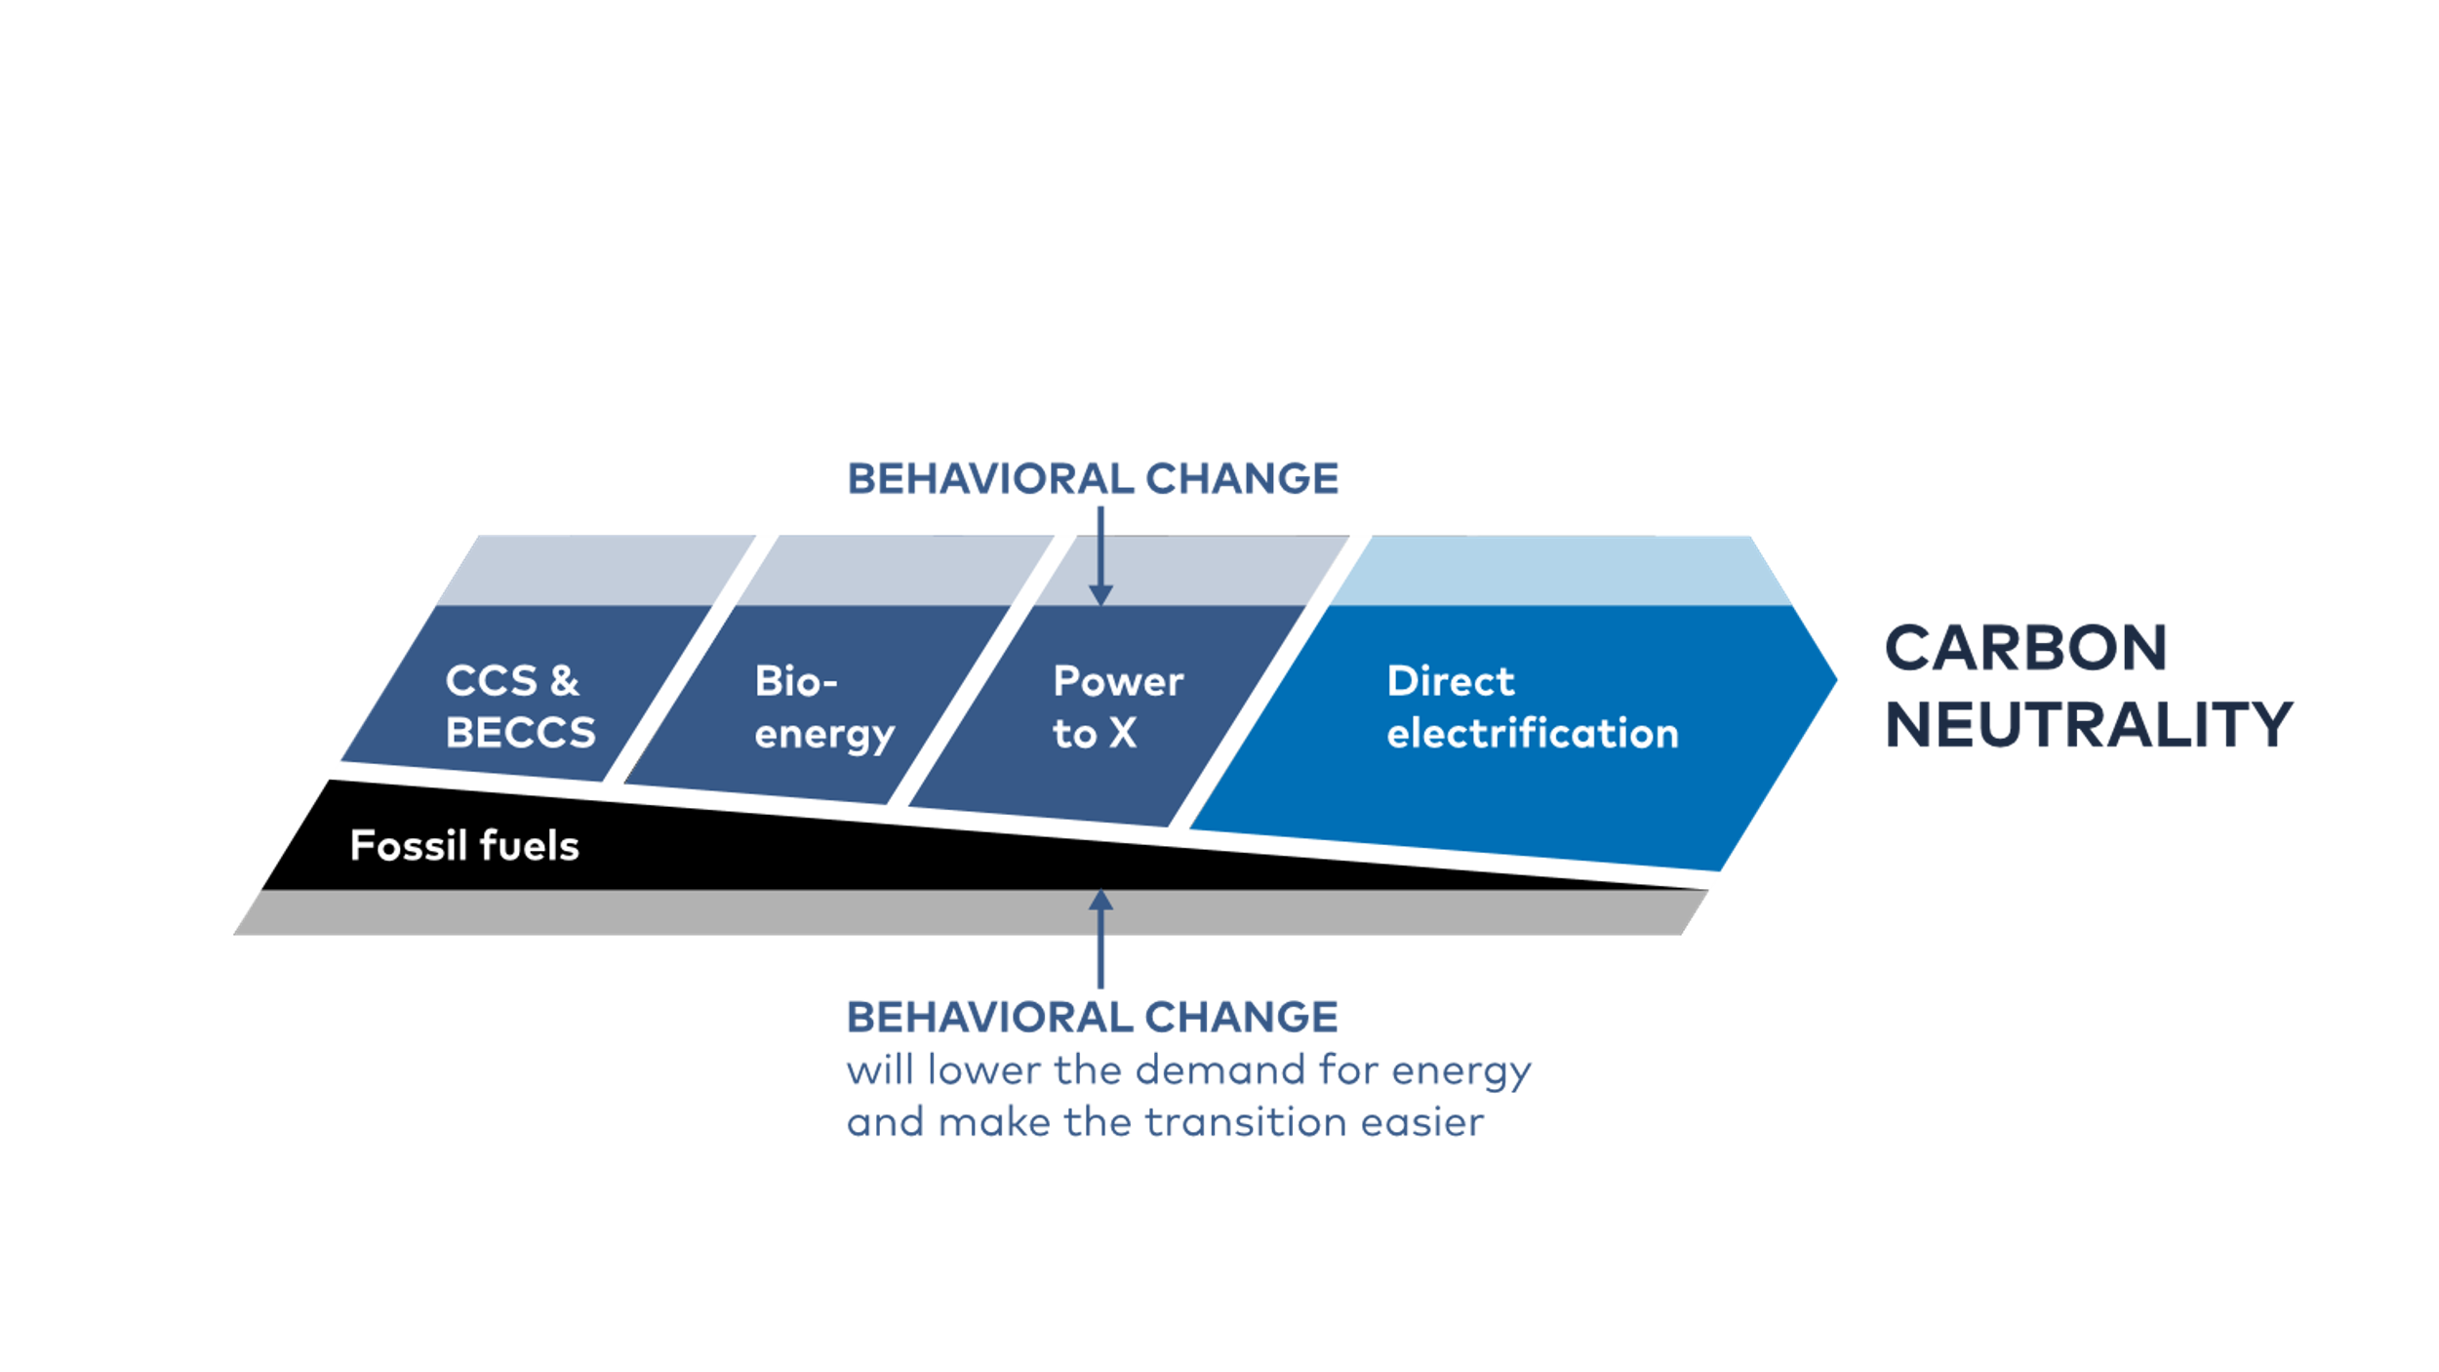
Five Solution Tracks to Carbon Neutrality
Notes:
There are a myriad of solutions to reduce energy use and emissions, and they pretty much fall into five tracks. And since many solutions require coupling sectors and businesses, we have organised our analysis around these five solutions tracks:
The first is direct electrification, where you replace fossil fuels with electricity directly, as in a battery electric vehicle. Direct electrification is at the core of all our pathways and as a rule of thumb: if it can be electrified directly, do it!
The second solution track is Power-to-X, where electricity is used to produce a fuel that in turn replaces a fossil fuel. Hydrogen is an example of this indirect electrification and of course there is a lot of hype around this right now. It’s really important to distinguish between these two forms of electrification direct and indirect, as we will see they have very different characteristics and effects on the system as a whole.
Bioenergy is our third track. It’s already a cornerstone of the Nordic energy system, and our analysis shows that it will continue to be a critical piece of the puzzle.
Carbon capture and storage, particularly combined with bioenergy to produce negative emissions, is essential to reduce the cost of reaching carbon neutrality as it buys us time and allows for some very hard to abate emissions to remain in the system.
Finally, we have lifestyle choices and options to change behaviour. This could both make the transition easier and harder, and although it’s often emotionally and politically sensitive to discuss, we need to recognise the importance of these factors as well.

Slide 4






Direct Electrification is Central to all Decarbonisation Strategies
Notes:
Let’s start with our central solution track, direct electrification

Slide 5
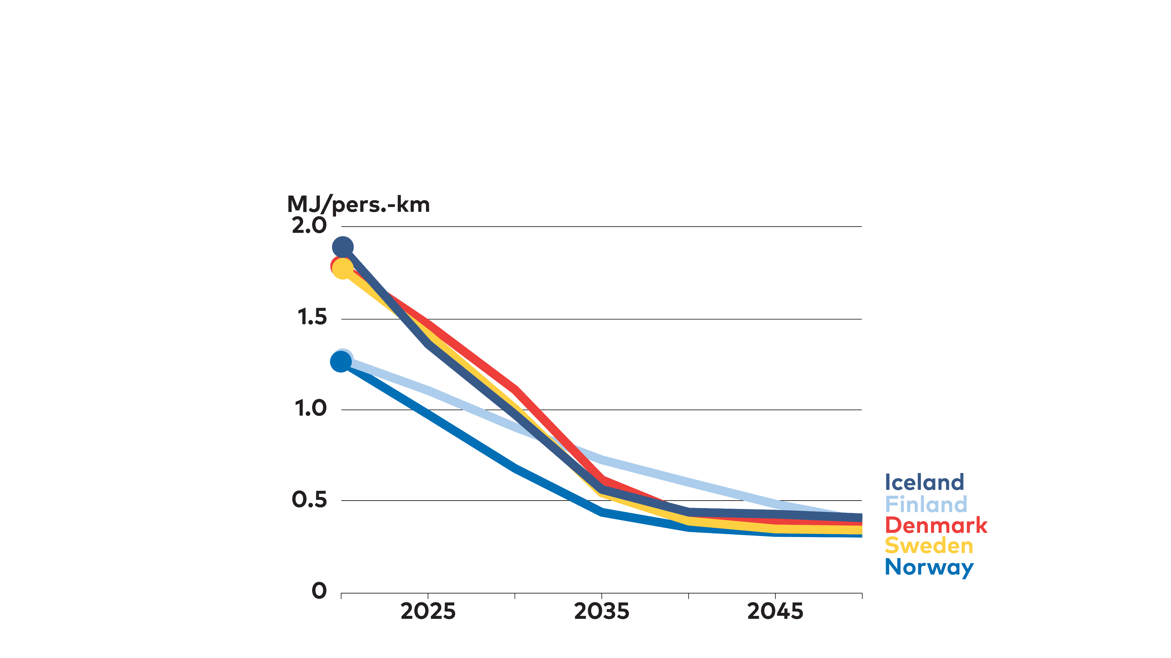
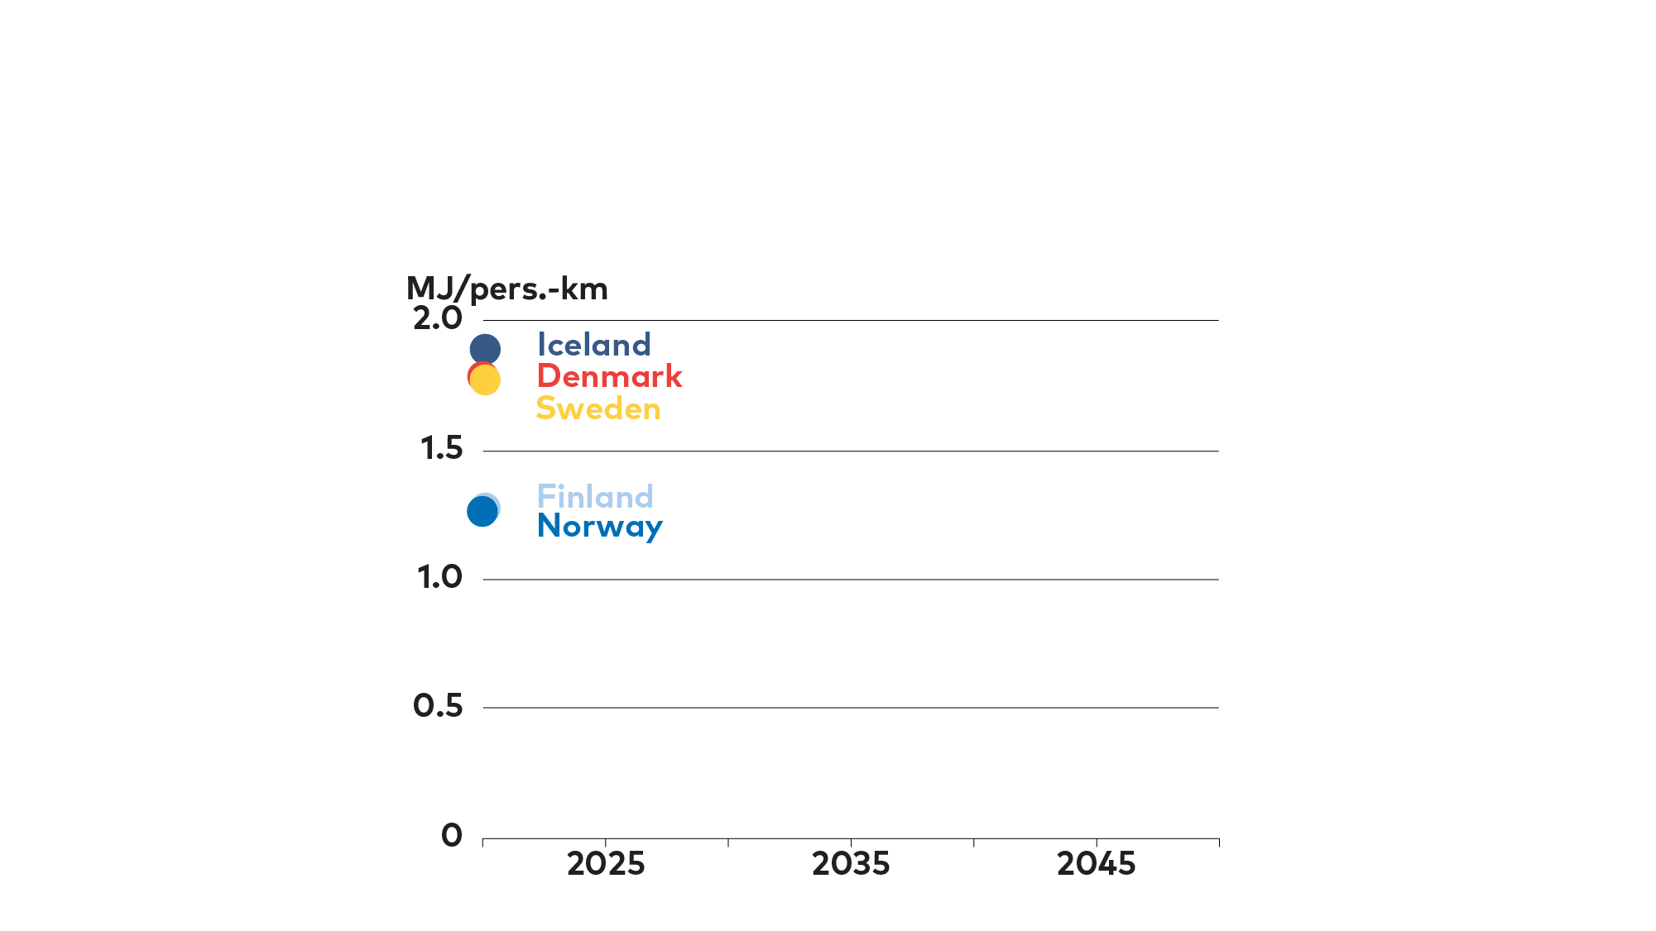
Direct Electrification Dramatically Improves Energy Efficiency
Notes:
Key points:
Substituting electricity for fossil fuels radically improves efficiency
This drives down costs and is a critical part of why this is happening
I would like to begin not by looking at emissions reductions but rather at the potential of electrification improve energy efficiency, as that is a key explanation to why we are so bullish on this solution track.
This graph shows the energy demand per passenger kilometer in the Nordic countries, and how it falls in our scenarios. A large chunk of this dramatic improvement is electrification. An electric vehicle typically converts 80-90% of the energy you put in it into mobility, whereas a typical gasoline car is lucky to reach 20%.
The same is true in many applications – electrification can dramatically improve energy efficiency. So much, in fact, that in several of our scenarios total Nordic primary energy demand falls substantially to 2050.

Slide 6
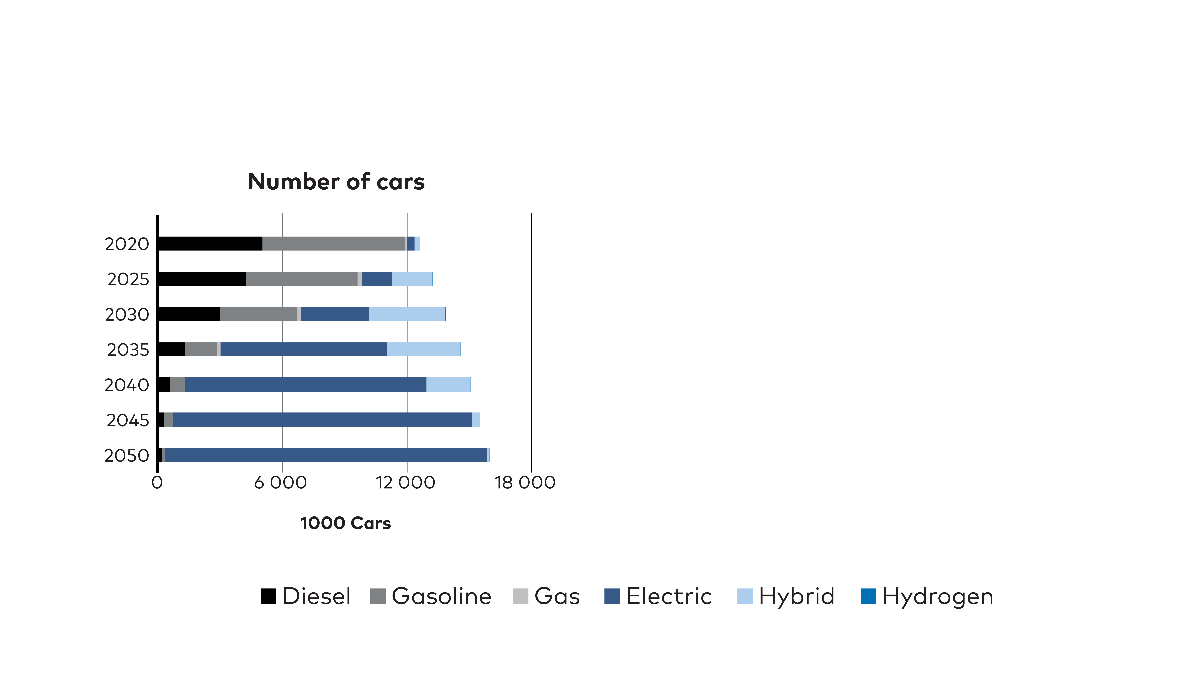
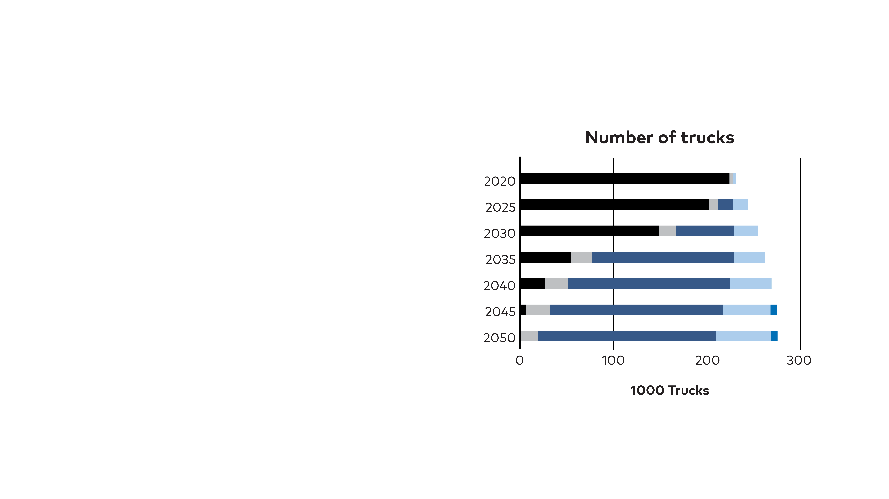
Direct Electrification is Accelerating in all Transport Modes
Stock of cars and trucks (incl. vans) CNN and NPH scenario
Notes:
Key points:
PLDV on track for fast transformation
EVs already cost competitive, no ICE sales by 2030
Trucks follow close behind, 5-10 yrs lag
Hard to see H2 or biofuels play a significant role
However, our scenarios rely on assumptions of continued improvement in battery technology, as well as roll out of charging infrastructure. PtX is a fallback.
Will reduce pressure on bioresources
Nordic coordination of physical infrastructure and “soft issues” like roaming for charging is needed to realise the potential
A prime example is the roll out of battery electric vehicles. Already today it is cheaper for most car owners to buy an EV, considering the total cost of ownership. In our scenarios we see EVs dominating the market after 2025, with the last ICE sold around 2030.
More surprising to some may be that we see similar development for trucks, just 5-10 years later. There is more uncertainty here, and the development is contingent on continued improvement in battery technology and, not least rapid scale up of charging infrastructure, including grid strengthening. But only five years ago, most analysts saw biofuels as a much more likely energy carrier than direct electrification.
One should note that the black bars contain a lot of blending with biodiesel, already an important part of Nordic truck fuels. So diesel does become greener overtime and biofuels are an important part of the transition.
Moreover, the EU strategy on hydrogen and the target to roll out a system of hydrogen filling stations, could make fuel cells more attractive. But we do not see it as competitive given the expected falling cost of direct electrification.

Slide 7
Electricity demand grows in all sectors, but the span is wide
Nordic electricity demand
Heating plants
Least cost (CNN)
Electricity intensive (NPH)
Aviation
TWh
Heating plants
800
Aviation
Transport – other
Transport – other
700
Truck
Truck
Car
600
Car
PtX fuels
500
PtX fuels
400
Heavy industry
Heavy industry
300
Residential
Residential
200
Data centres
Data centres
100
Manufacturing
and other sectors
Manufacturing
and other sectors
0
2015
2025
2035
2050
2015
2025
2035
2050
Notes:
Key points:
Direct electrification, built on clean electricity supply, is the cheapest and most efficient way of reducing CO2 emissions.
Electricity demand increase in all sectors
PtX production the single largest growth segment
There is potential for further electrification than what these graphs show.
Barriers exist:
DHC are designed for high temperatures and centralized dispatch
Tariff structures do not reward flexibility
Industry can be slow to adopt new tech
Grids
Charging
So if we zoom out and look at the entire economy we do see a significant increase in electricity demand, as this graph shows. However, those of you who have followed the public discussion on potential future electricity demand may be surprised that the growth is not even stronger.
We did model a scenario with more positive outlook on the cost of electrification, on growth in energy intensive and on the use of PtX fuels such as hydrogen. As you see the production of hydrogen quickly becomes a big chunk of total new electricity demand, easily dwarfing that of transport. We will return to that in a minute.
So to end – as a rule of thumb: electrify everything that you can directly.
And in fact, we have by no means exhausted all potential options for direct electrification in our scenarios. Our base scenarios contain 150-400 ‘new’ TWh of electricity demand. But if we tweak assumptions a little on things like industry uptake of new technologies and transformation of space heating, demand could increase another 200 TWh.

Slide 8
Power-to-X and Hydrogen is not just Hype
Notes:
We have spent substantial effort looking at the potential of Power to X, or put differently hydrogen and derivatives of that, to help meet Nordic climate targets.

Slide 9
…but is not necessarily the cheapest option
Nordic hydrogen production and associated electricity demand in 2050
Hydrogen production
Electricity for hydrogen production
Least cost (CNN)
Very High PtX
2050
Notes:
Key points
Interestingly, in our cost minimising scenario we don’t actually see all that much hydrogen. Instead more CCS and bioenergy
So hydrogen and PtX fuels are not necessarily the cheapest solution but could see strong growth.
Recognising the push, not least from industry and the EU, we also modelled scenarios with higher PtX demand, driven by more optimistic cost assumptions and also forcing the modelling in this direction
The potential impact on electricity demand is big. The graph shows Nordic hydrogen production in two scenarios and the associated electricity production. Note that both scenarios meet the carbon neutrality target.
Of course we also have potential production of blue hydrogen, that is from natural gas combined with CCS .

Slide 10
Significant Impact on Nordic Electricity Production
EU hydrogen demand offers export revenues but put pressure on the electricity system
CNN
Notes:
If we then add the European perspective we get more leverage of course, and the numbers start getting pretty daunting.
Key points:
EU hydrogen strategy will have very big impact on the Nordic energy system
If EU goes for hydrogen the way it is laid out in the strategy, almost no matter what we do PtX production will be the largest source of electricity demand by a long way
The potential span is very big
This is a big opportunity for Nordic energy firms – we can either export clean electricity or PtX fuels. 500 TWh of energy, equalling 20-30 bn euros per year.
Wind power makes up the bulk of needed power gen
Wind power expansion likely limited by acceptance for both turbines and associated grids, not lack of demand or cost competition.
Likely worth paying a premium for e g offshore wind to ease pressure on land and improve acceptance
Timing will be hard – not likely that production capacity for green hydrogen will match exactly the expansion of clean electricity. So likely there will be a period of imbalance in the market.
A very important conclusion is that the Nordic countries will benefit A LOT from tacking this development with close coordination. At the very least exchange information over plans, and even better discuss common strategies to maximise benefits and minimise risks for unwanted spillover effects.
Put bluntly – PtX exports make sense from economic and climate perspective, but will have significant impact on Nordic landscape and nature.

Slide 11
Bioenergy Remains Important, but with a Shifting Role

Slide 12
Three Bioenergy Takeaways
Development in transport electrification could lower the pressure on bioenergy resources
Biomass and biofuels play an important interim role in most sectors
Maintaining sustainability despite increased demand will continue to be an important topic
Notes:
The development in electrification of road transport lowers the future pressure on bioenergy resources compared to what was expected a few years ago.
Biomass and biofuels can fill gaps in short to medium term in most sectors.
Sustainability issues and other demands for bioenergy, as for chemicals and materials, need a lot more attention.

Slide 13
Bioenergy Use Increase
…but growth in demand for liquid biofuels is significantly lower than in previous studies
TWh
600
500
Waste
400
Agriculture
Forest
300
Upstream fuel production
Imported biofuels
200
Residential
Power and heat
100
Industry, Commercial
and Agriculture
0
CNN
NETP2016
Nordic
Potential
2020
2030
2050
Notes:
…But growth in demand for liquid biofuels is significantly lower than in previous studies
The Nordic countries can easily stay within own biomass potential
Biofuel demand for transport in 2050 was 130 TWh in NETP2016, while in CNN it reaches 60 TWh

Slide 14
Carbon Capture and Storage, along with Negative Emissions, are Essential to Reach Nordic Climate Neutrality Targets

Slide 15
All scenarios reach national targets but amount of CO₂ captured in 2050 depends on cost and acceptance
7.5ton CO₂
7ton CO₂
5ton CO₂
4ton CO₂
0.5ton CO₂
1.5ton CO₂
6.5ton CO₂
2.5ton CO₂
6ton CO₂
6.5ton CO₂
Notes:
Original title: Amount of CO₂ Captured Varies Depending on cost and acceptance

Slide 16
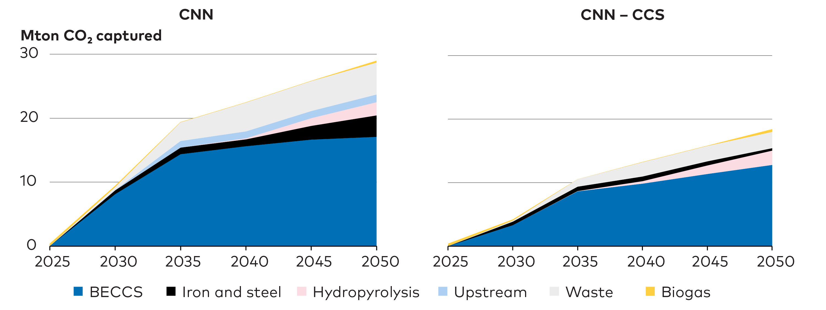
Negative emissions are necessary to reach Nordic national targets
From 2025 CO₂ capture need to increase at a rapid rate until 2035
90% of captured CO₂ is from biogenic sources and 10% from fossil
20-30% of captured CO₂ in 2050 are reused for fuel production
Notes:
From 2030 onwards the contribution from carbon capture technologies takes off significantly, reaching 15-25 Mt captured CO₂ annually in the CNN scenario (Figure 6.5). Almost 90 % of the capture takes place after 2035. 70-80 % of the captured CO₂ is sent to storage and 20-30 % used for fuel production.
Should CCS become 20-60% more expensive than expected investments in alternative mitigation options will increase leading to direct CO₂ emissions, especially from industry, reducing more and earlier.

Slide 17
Remaining Emissions in the CNN Scenario
~ 170 Mton
About 33 Mton of energy-related CO₂ emissions remain in hard-to-abate sectors by 2050.
~ 33 Mton
Notes:
Nordic CO2 emissions 2020 ~ 170 Mton
Nordic CO2 emissions 2050 ~33 Mton
Net emissions ~8 Mton (from international transport and oil and gas extraction)

Slide 18
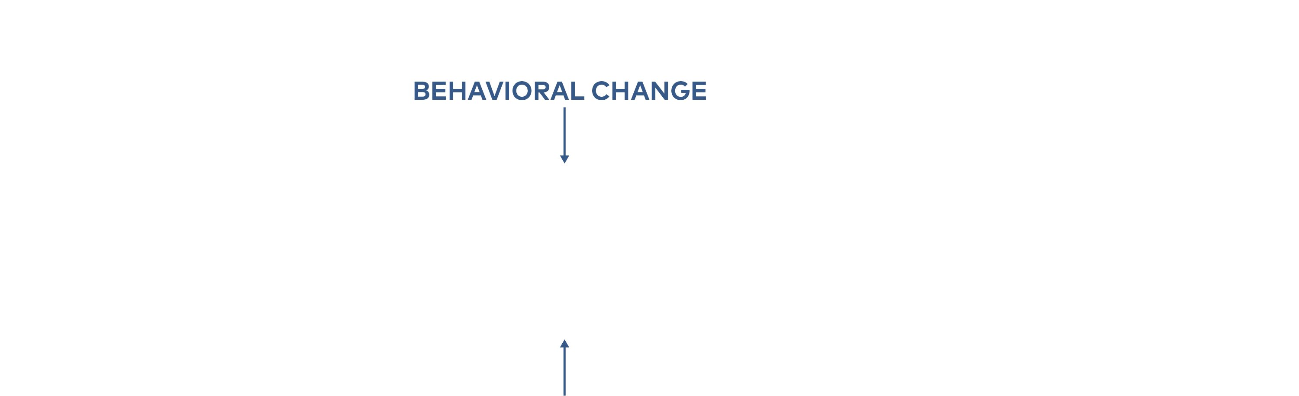
DON’T MOVE OR RE-ANIMATE THIS FIGURE
Behavioral change and social acceptance will directly impact the Nordic energy transition
Notes:
Behavioural change and social acceptance for infrastructure must be considered

Slide 19
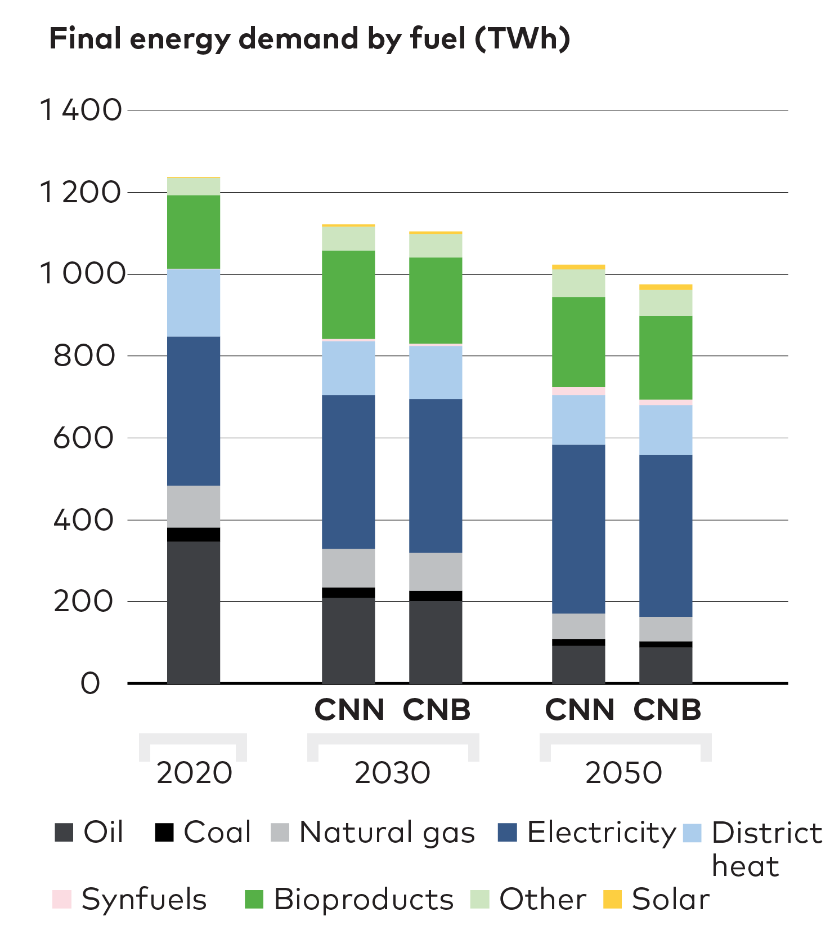
The CNB Probes Different Ways to Disrupt Historical Trends
Passenger transport demand stabilises
Consumption is reduced
Increase of car sharing
Notes:
What if:
Passenger transport demand stabilises on 2019 level including aviation
Lower consumption drives down production and freight transport by 10% in 2050
Car sharing becomes popular

Slide 20



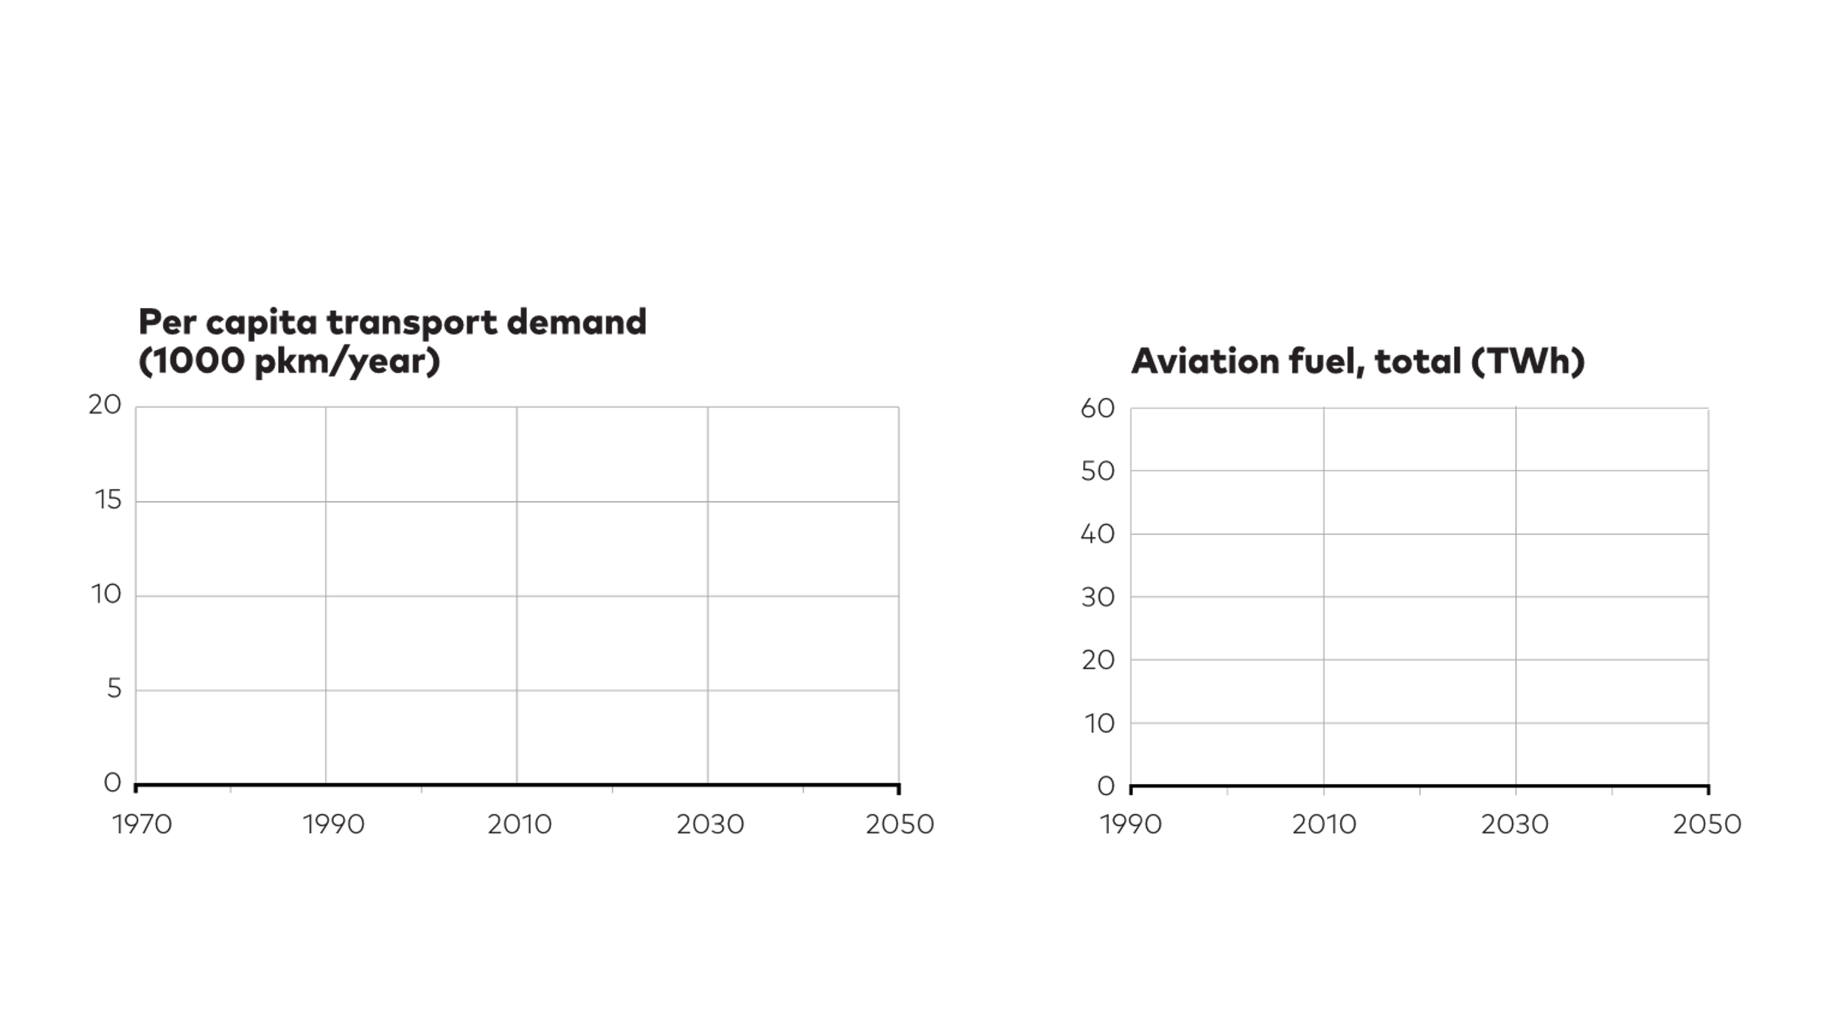
Behavioural Change Could Dramatically Reduce the Transition Cost

Slide 21

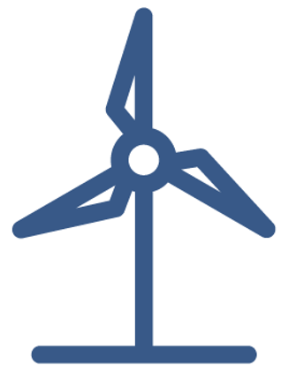
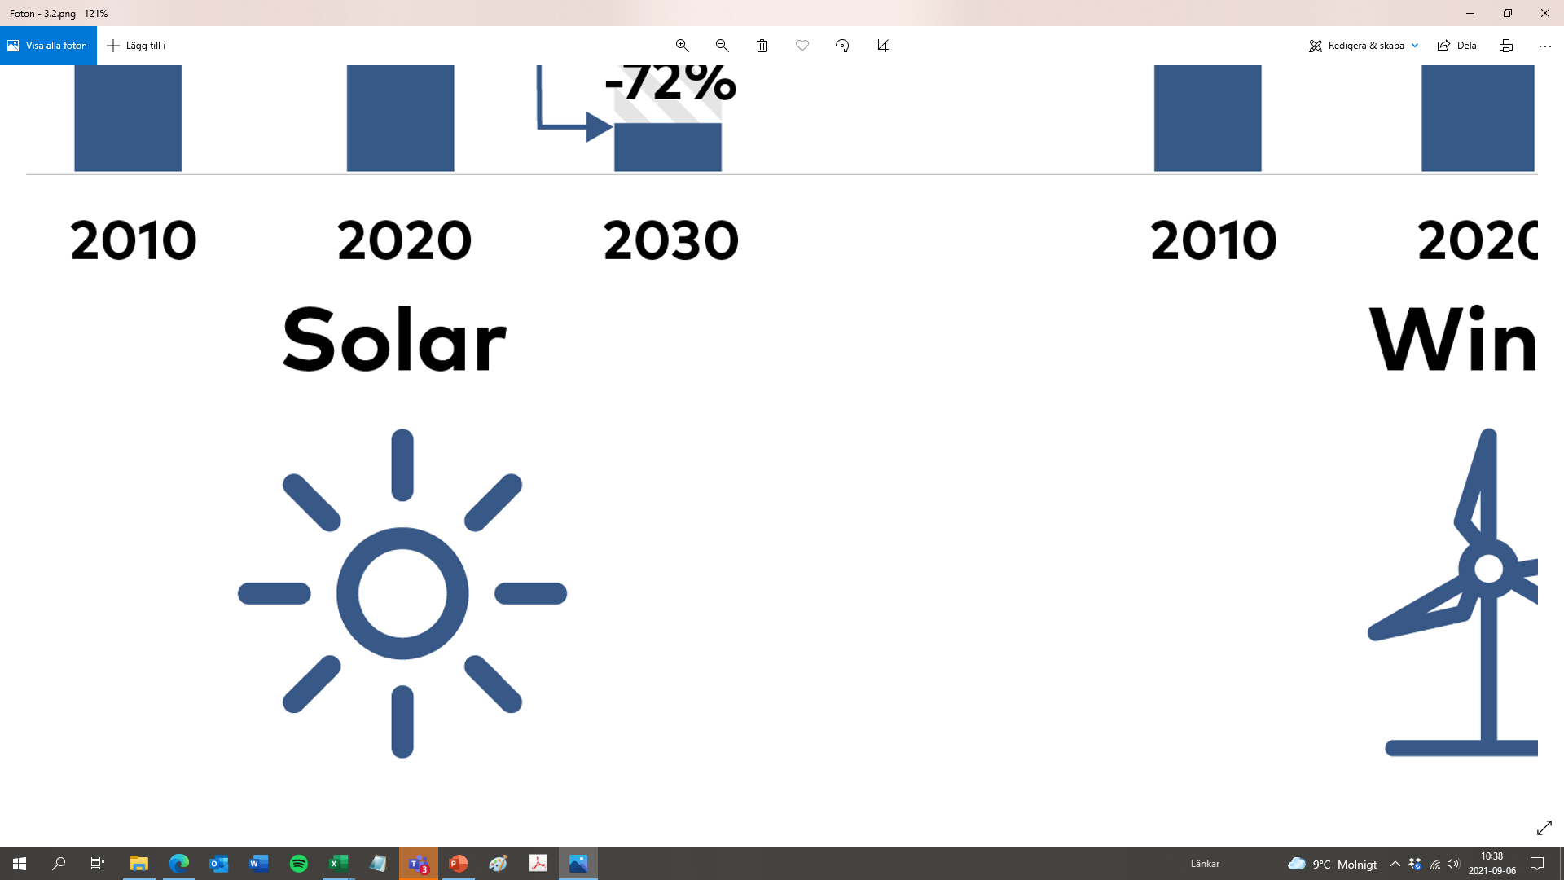
113 GW
Public acceptance of onshore wind, solar PV and transmission lines will impact transition feasibility
100 GW
56 GW
49 GW
40 GW
31 GW
19 GW
1.6 GW
2020
CNN 2050
NPH 2050
HighPtX 2050
Notes:
1 icon = 5 GW
2020 PV = 1.6 GW (part incon), onshore wind = 19 GW (4 icons)
CNN2050 PV = 31 GW (6 incon6), onshore wind = 49 GW (10 icons)
NPH2050 PV = 40 GW (8 incons), onshore wind = 56 GW (11 icons)
HighPtX2050 PV = 100 GW (20 incons), onshore wind = 113 GW (23 icons)
So no space for number on top :-)
Never say never ☺ / Madde

Slide 22
Thank you.

Slide 23
The results show that it is possible, but we must prioritise
The pace of transformation must increase
A transition that is socially acceptable
A transition that is low in cost
Long-term business strategy
Supporting the European transition

Slide 24

Four target areas for Nordic collaboration
CCS
BECCS

Slide 25
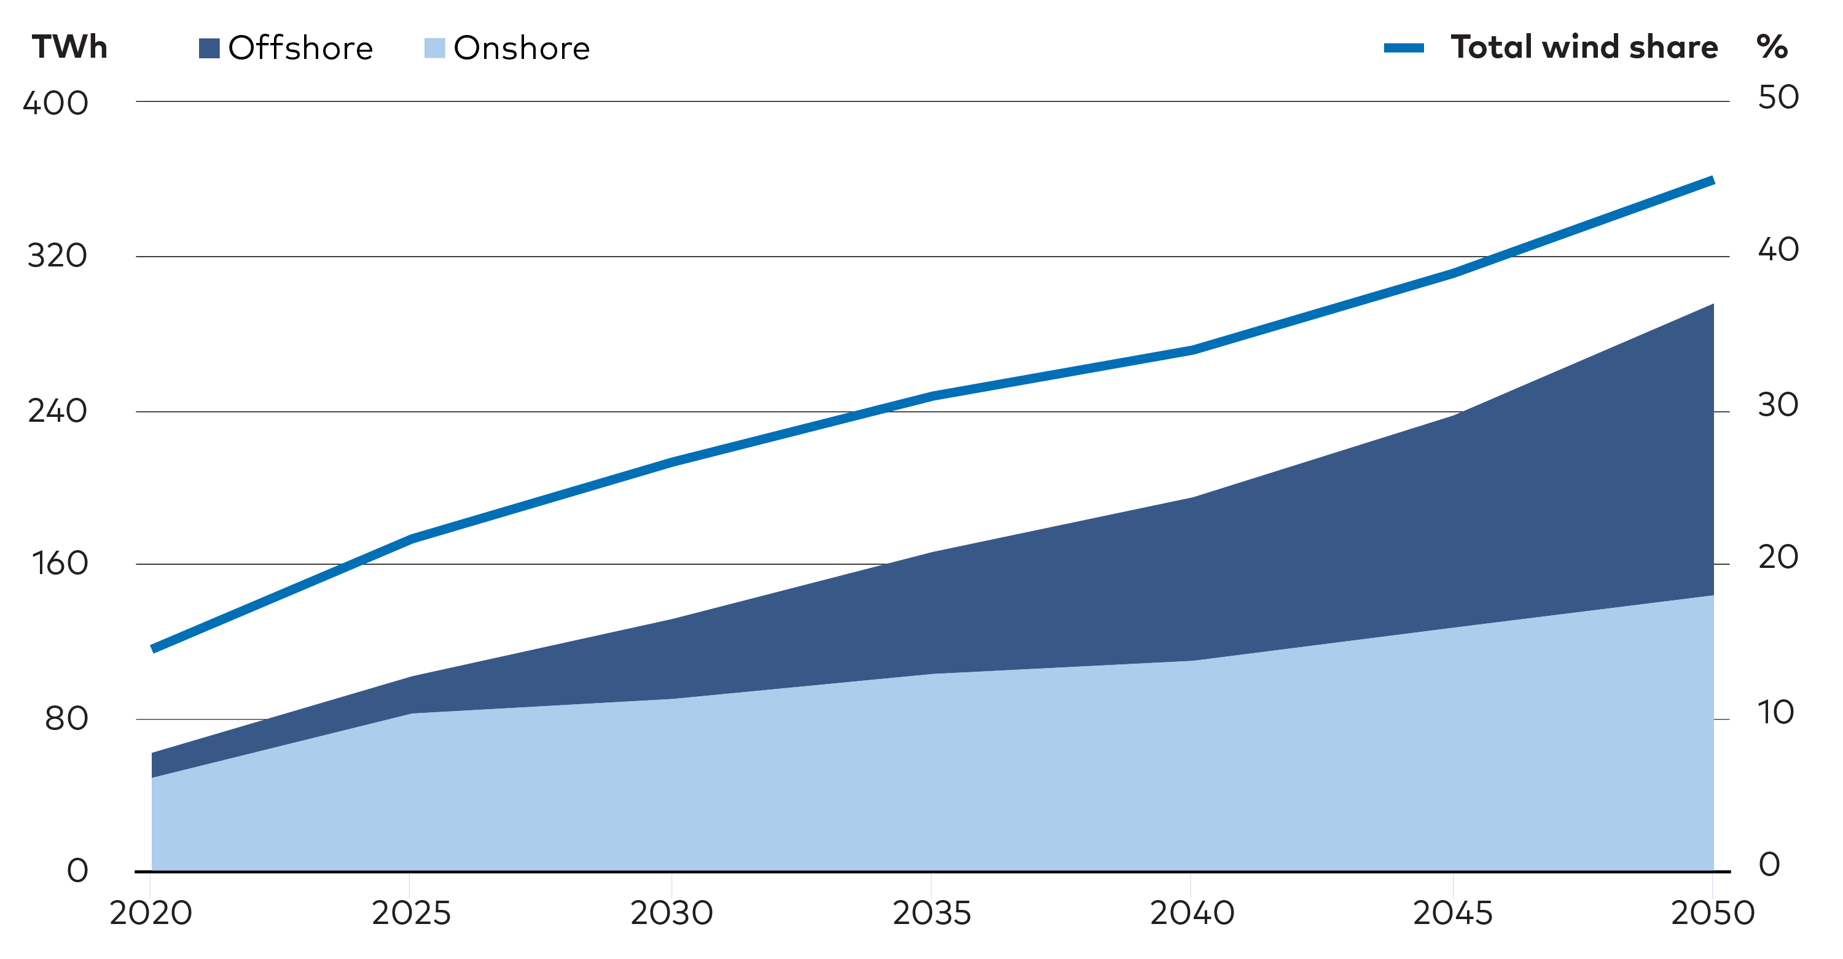
Nordic cooperation on integrated offshore wind and grid development

Slide 26
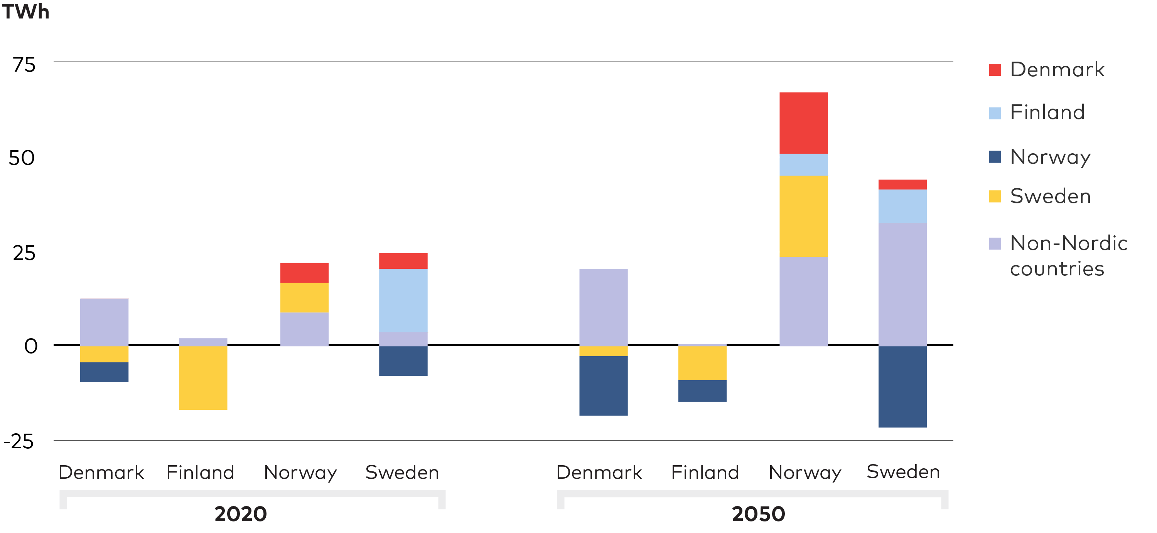
Common Nordic power infrastructure planning

Slide 27
Common vision for the role of PtX production in the Nordics
Electricity for hydrogen production
Hydrogen production

Slide 28
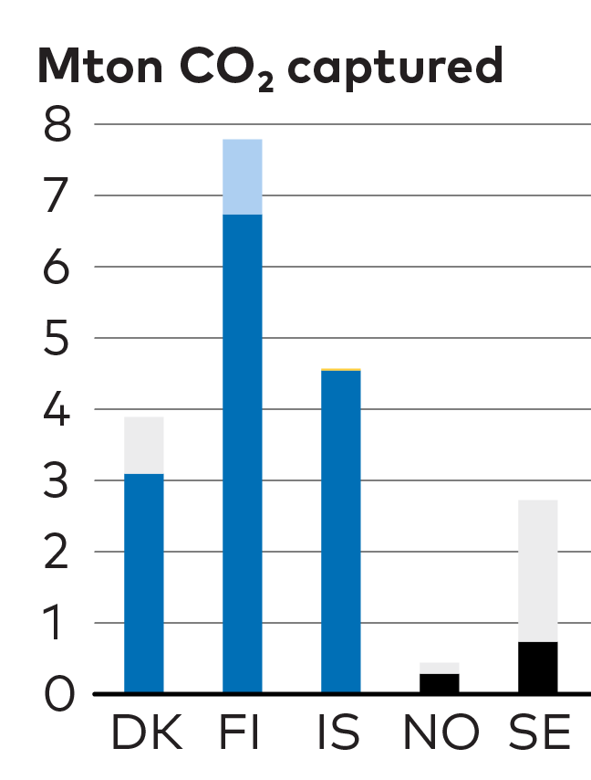
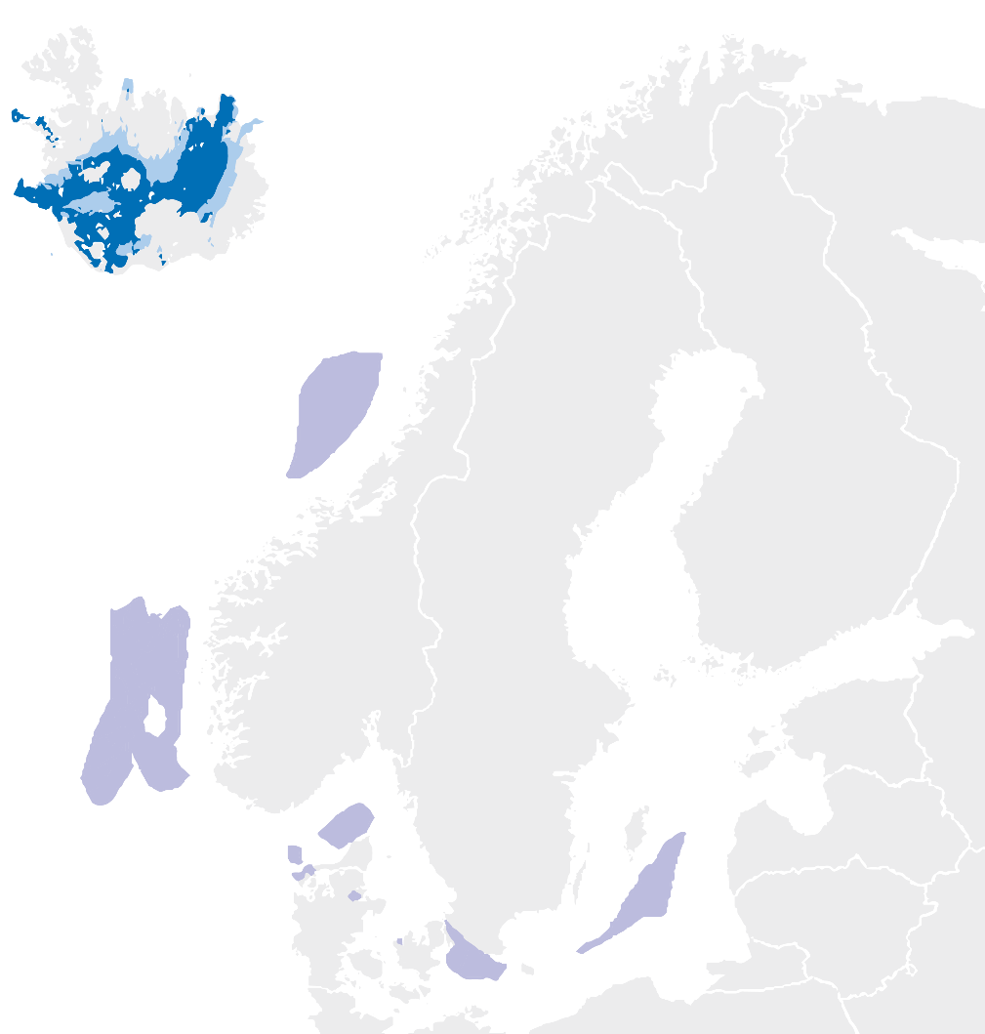
Common Nordic CCS strategy
CCS
BECCS
CNN
2050
Notes:
Stronger coordination of and commitments to Nordic power infrastructure planning
Nordic cooperation on integrated offshore wind and grid development
Common vision for the role of PtX production in the Nordics
A common Nordic CCS strategy

Slide 29
Successful coordination in these areas lead to more efficient solutions at a lower cost

Slide 30










Project Partners

Slide 31

Access the Nordic Clean Energy Scenarios report at
WWW.NORDICENERGY.ORG
Notes:
Concluding, going through the supplementary materials available at our website.

Slide 32
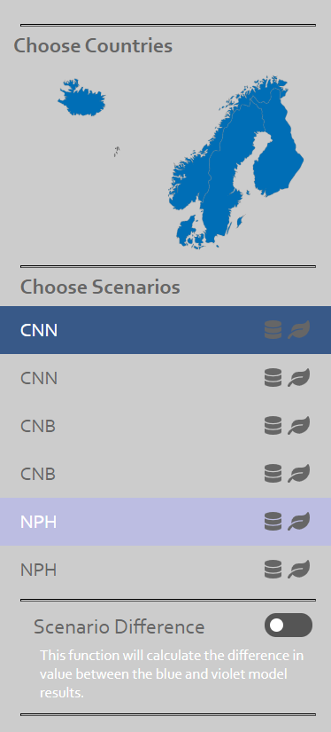
Explore all data and results through NCES open access tools
AVALABLE AT
WWW.NORDICENERGY.ORG
Open access models
Nordic energy statistics database
Complete technology catalogue
Web tool for scenario results and sensitivity analyses
Notes:
Concluding, going through the supplementary materials available at our website.

Slide 33
NORDIC CLEAN ENERGY SCENARIOS
Solutions for Carbon Neutrality
Thank you!

