Slide 2
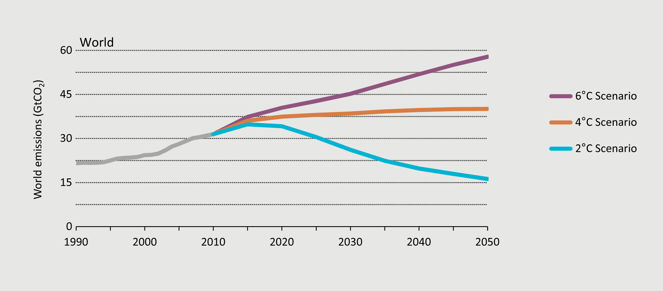
Global energy-related CO₂ emissions
from Energy Technology Perspectives 2012

Slide 3
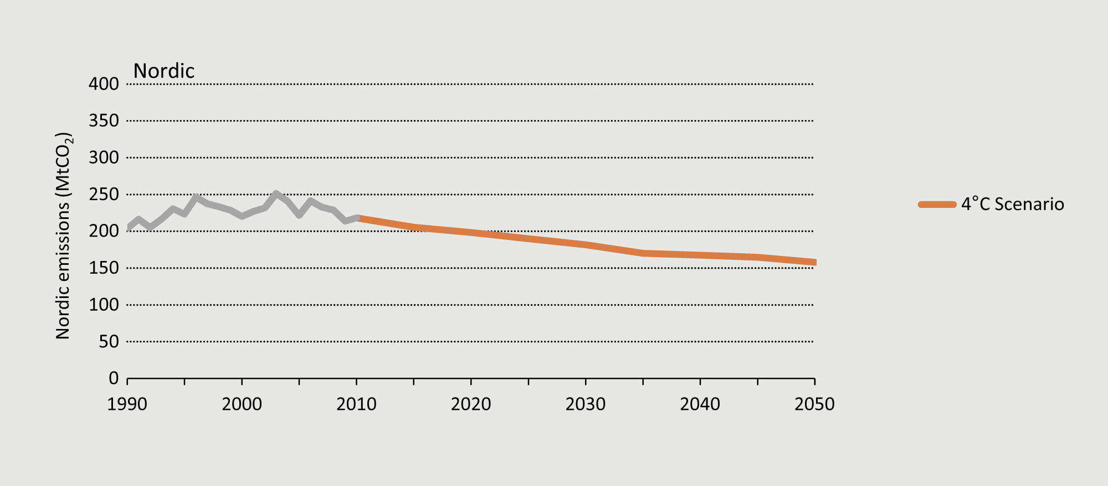
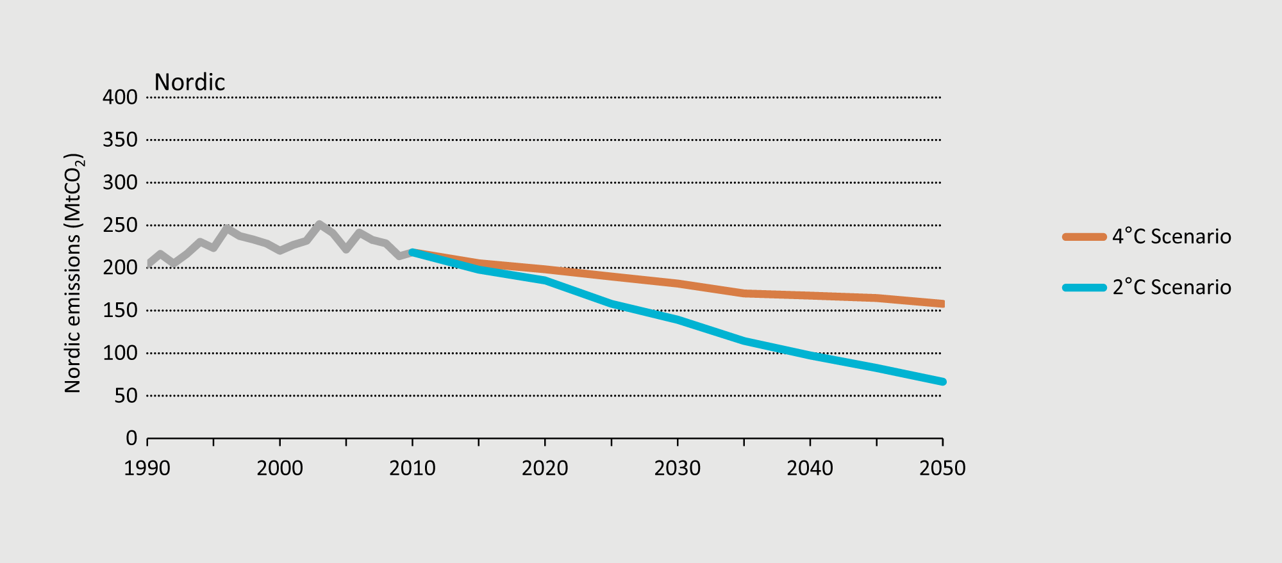
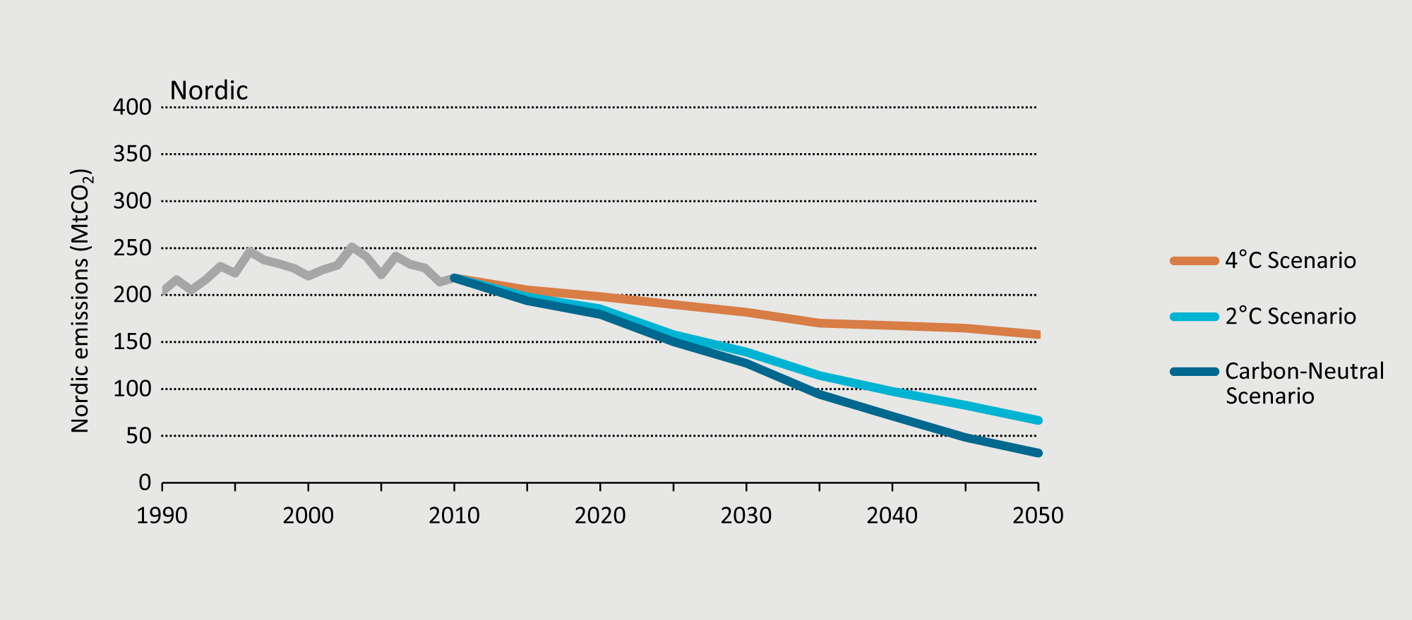
Nordic energy-related CO₂ emissions
The Carbon-Neutral Scenario sees Nordic emissions drop 85% compared to 1990 levels, with the rest of the world pursuing the 2C scenario.

Slide 4
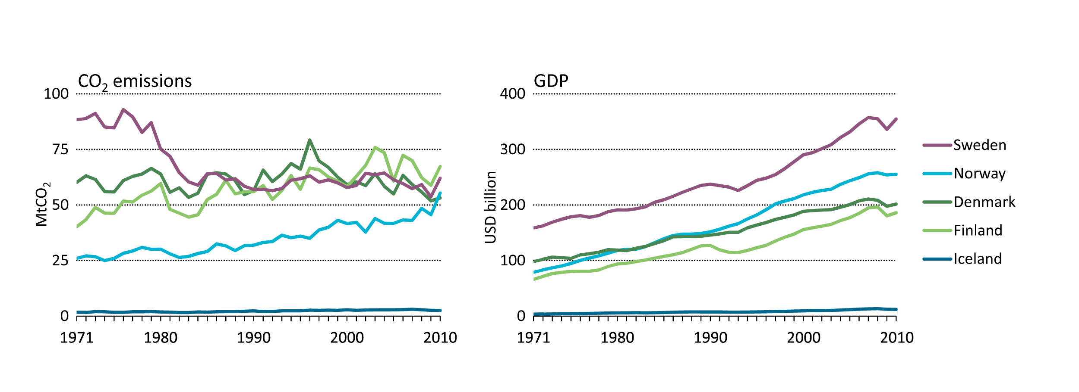
Decoupling of Nordic CO₂ emissions and GDP
The Nordic region has seen a steady increase in GDP while limiting CO₂ emission growth
Notes:
The significant drop in Swedish emissions is due to the increased use of nuclear power and the use of bioenergy in district heating.

Slide 5
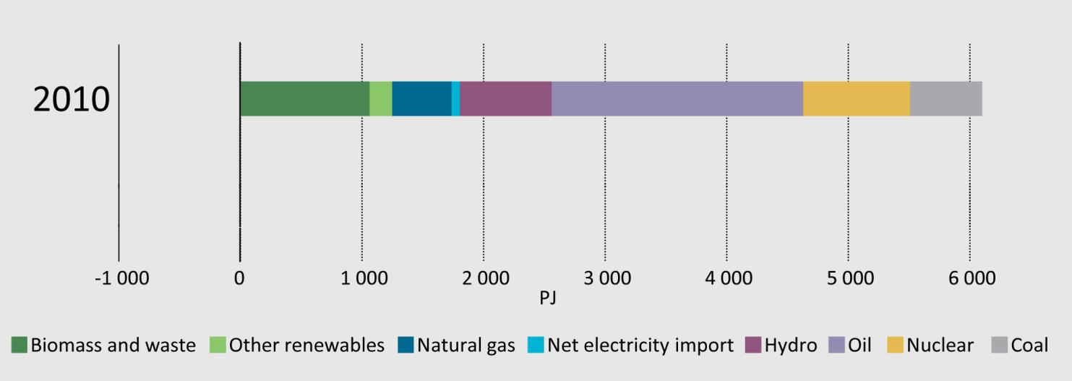
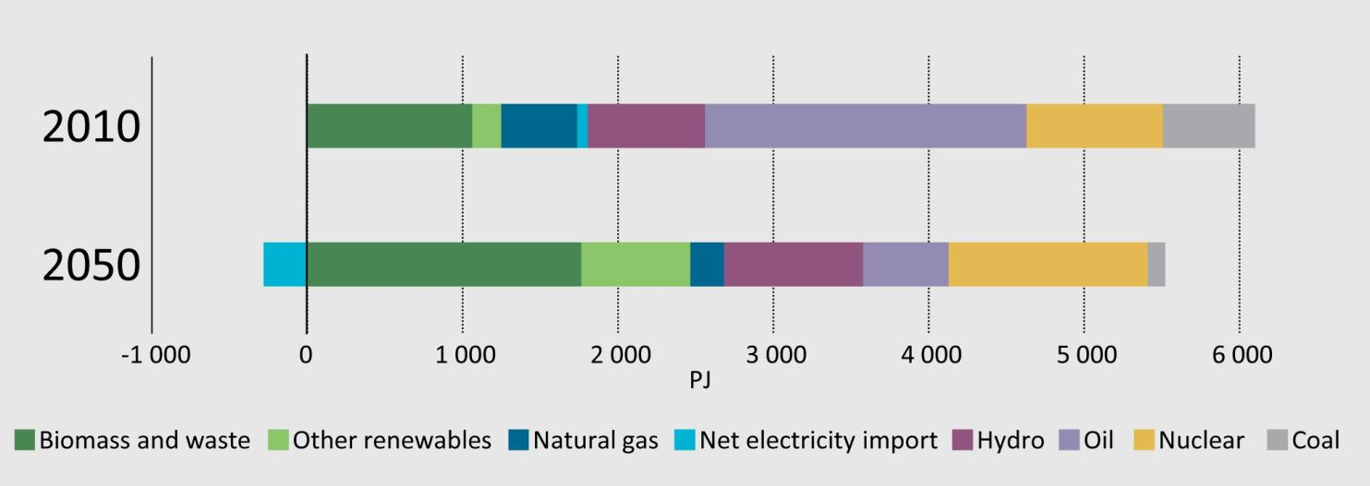
Nordic total primary energy supply in the Carbon-Neutral Scenario
Biomass replaces oil to becomes the largest energy source, growth in wind power contributes to net electricity export in 2050

Slide 6
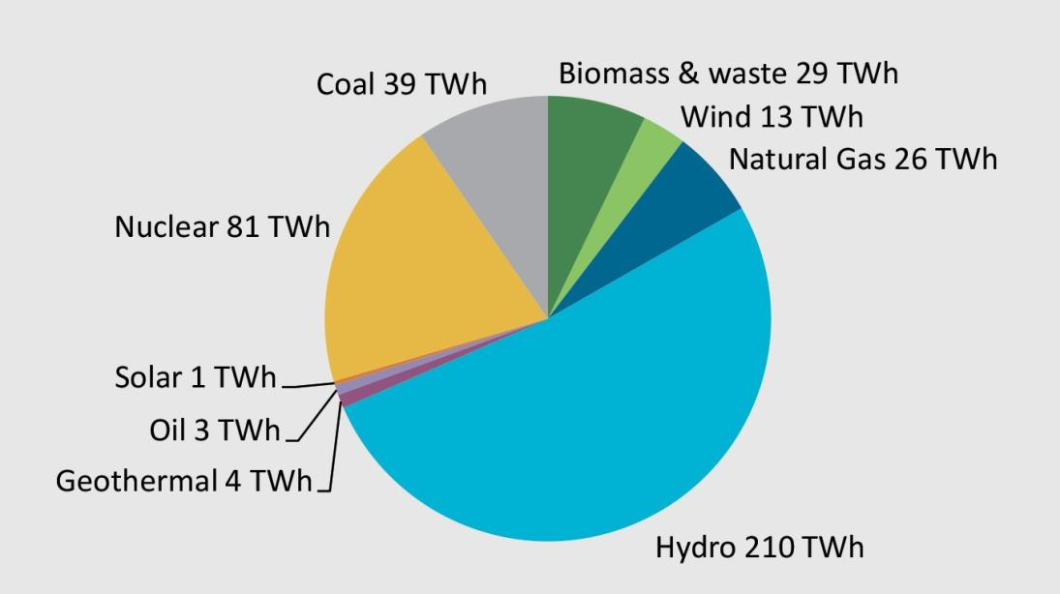
Nordic electricity generation in 2010
65%
Renewable
85%
Carbon-free

Slide 7
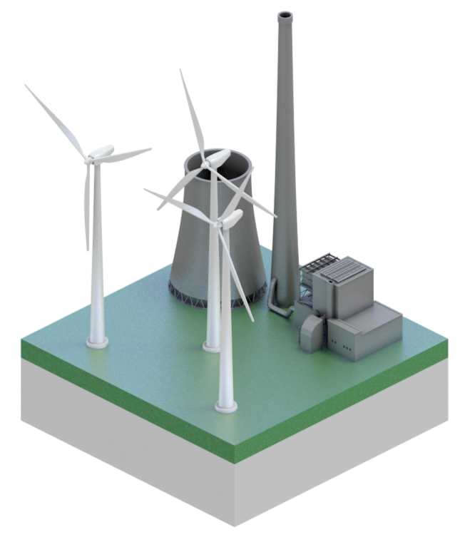
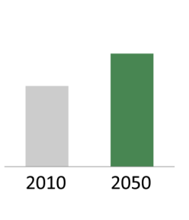
Nordic power generation in the Carbon-Neutral Scenario
80%
Renewable
in 2050
40%
generation
increase

Slide 8
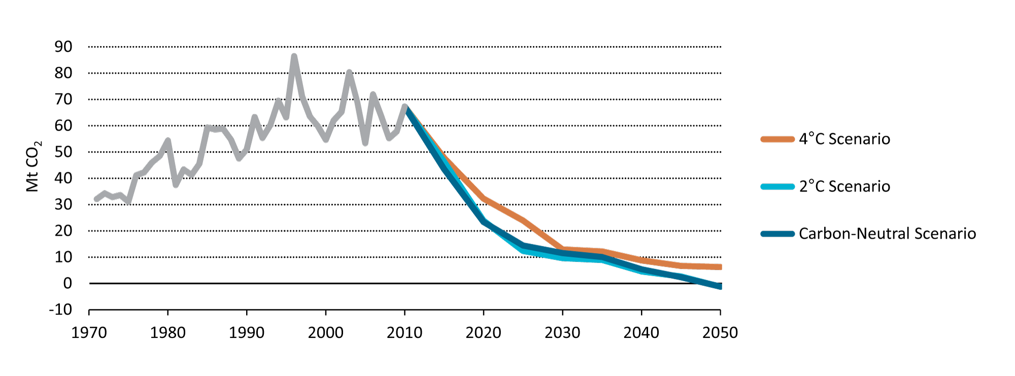
Nordic CO₂ emissions from power and heat generation
Power and heat is decarbonised in all scenarios

Slide 9
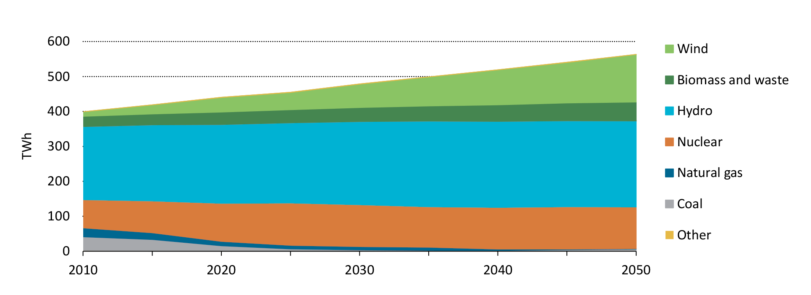
Nordic electricity generation in the Carbon-Neutral Scenario
Up to a 10-fold increase in wind generation
from 3% of total generation in 2010 to 25% in 2050

Slide 10
Nordic wind capacity in 2010: 6GW
Accounting for 3% of electricity generation

Slide 11
40GW of Nordic wind capacity in 2050 in the Carbon-Neutral Scenario
Requiring 10 000 new onshore turbines, 3 000 new offshore turbines
Notes:
From 6GW in 2010

Slide 12
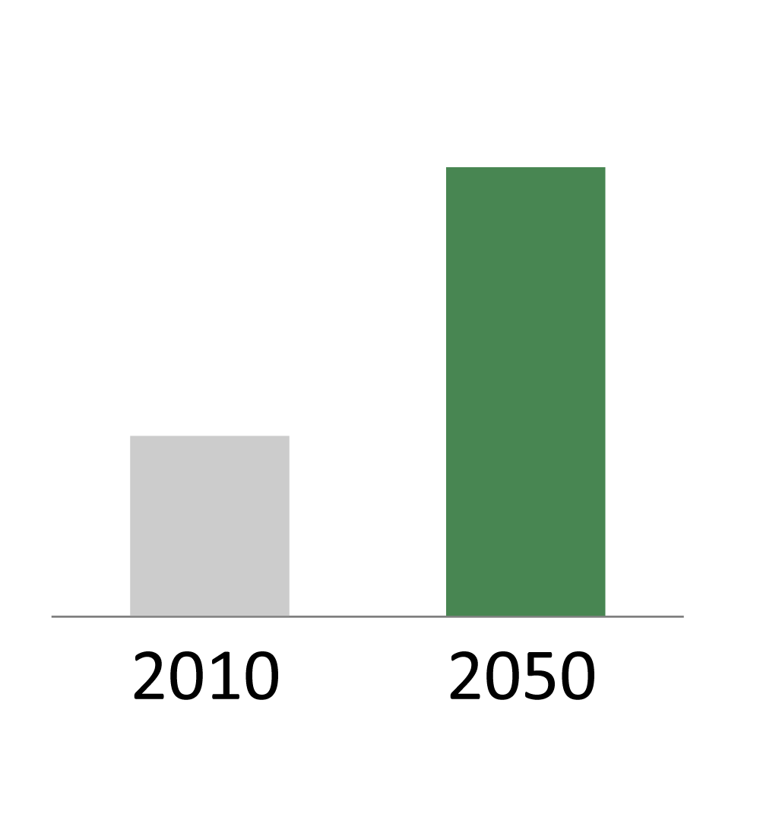
Infrastructure: Extra-Nordic transmission capacity in the Carbon-Neutral Scenario
up to
15GW
6GW

Slide 13
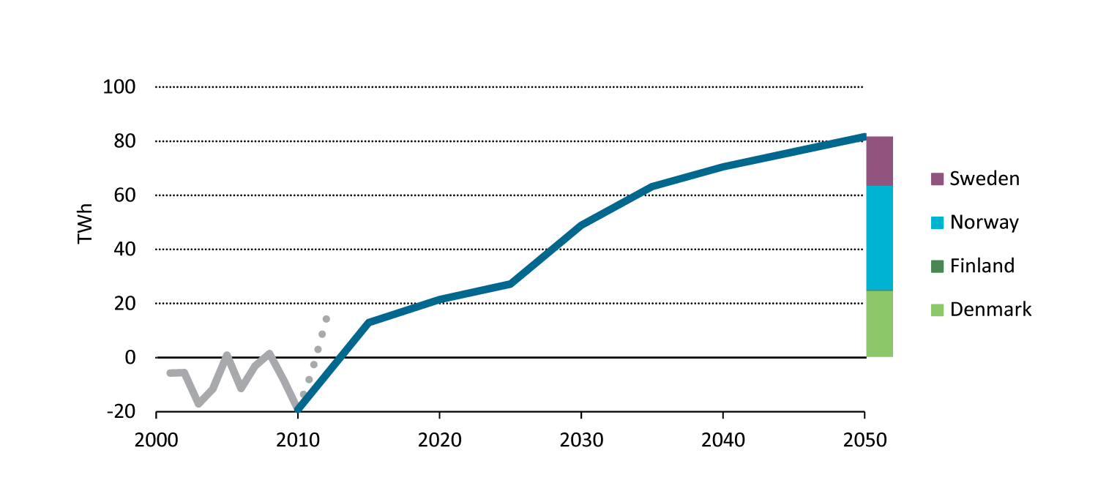
Nordic net electricity export in the Carbon-Neutral Scenario
Interconnectors from Norway, Denmark and Sweden could facilitate a significant increase in exports of clean electricity to Continental Europe

Slide 14
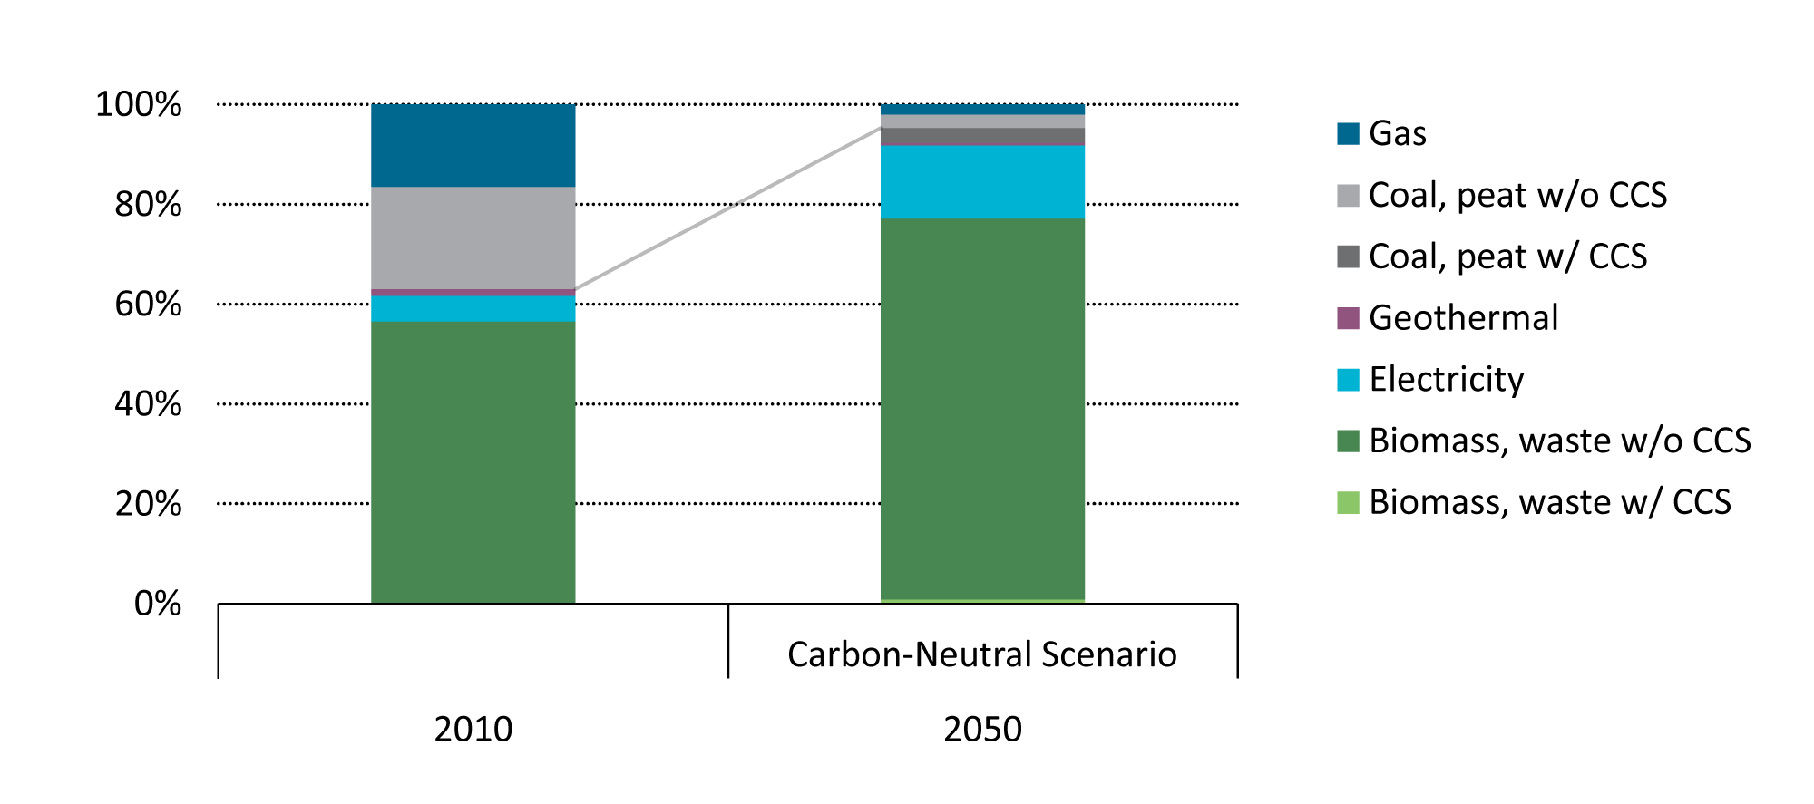
Nordic district heating mix by fuel
District heating is virtually decarbonised in 2050

Slide 15
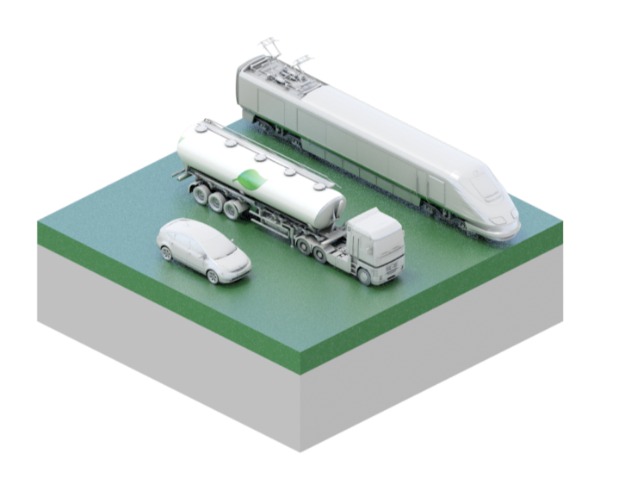
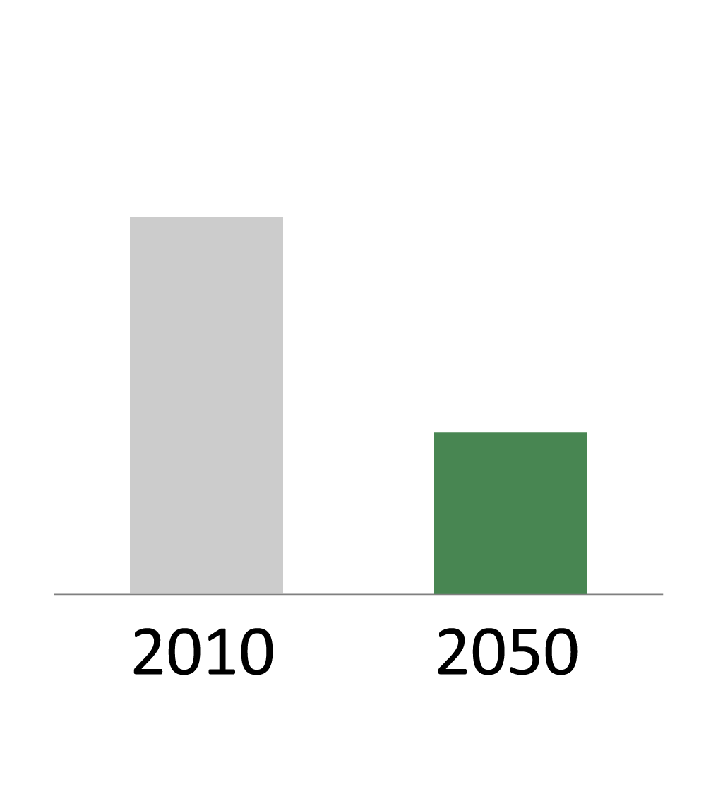
Transport: Light-Duty Vehicle (LDV) fuel economy in the Carbon-Neutral Scenario
0.7
l/10km
0.3
l/10km
Energy efficiency accounts for the majority of
transport emission reductions in the short-term

Slide 16
EV share of total Nordic car sales in the Carbon-Neutral Scenario
30%
90%
in 2030
in 2050
Sales of EVs must double every year for the next decade

Slide 17
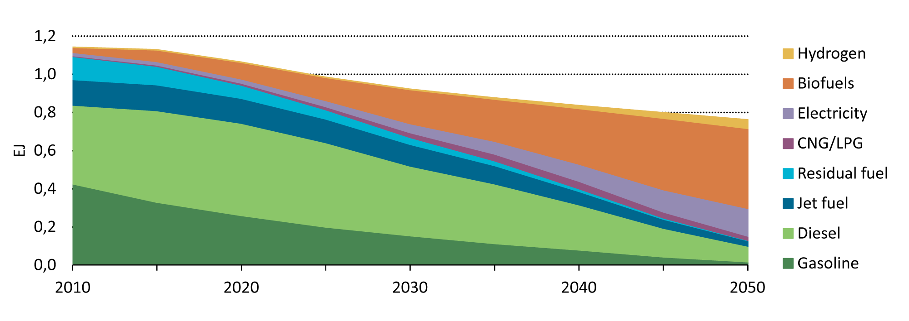
Nordic energy use in transport in the Carbon-Neutral Scenario
Biofuels account for 50% of total energy use in transport in 2050

Slide 18
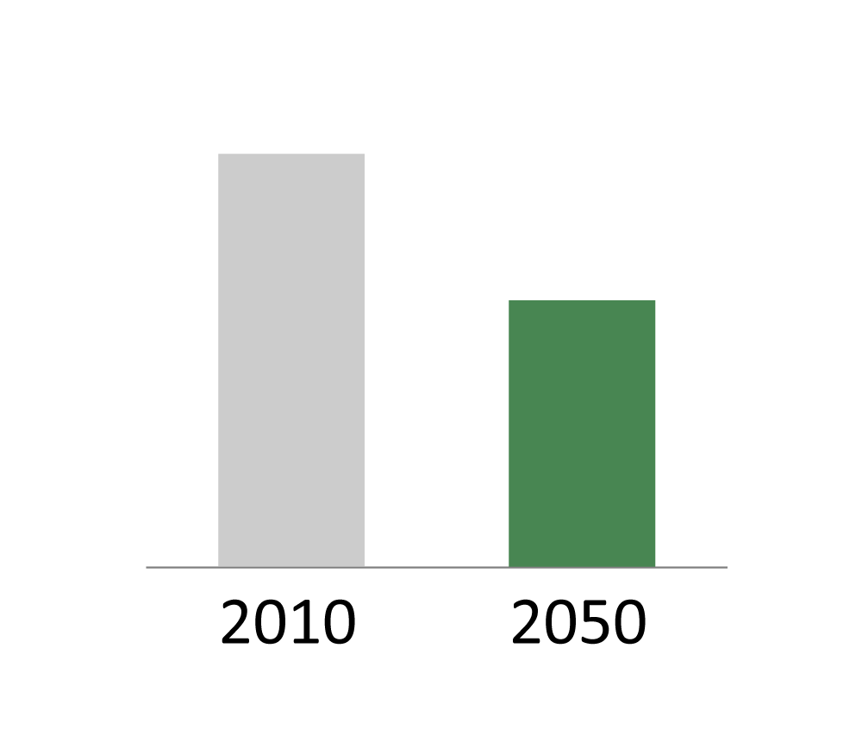
Buildings: Energy efficiency improvements in the Carbon-Neutral Scenario
35% drop in residential energy use per m²

Slide 19
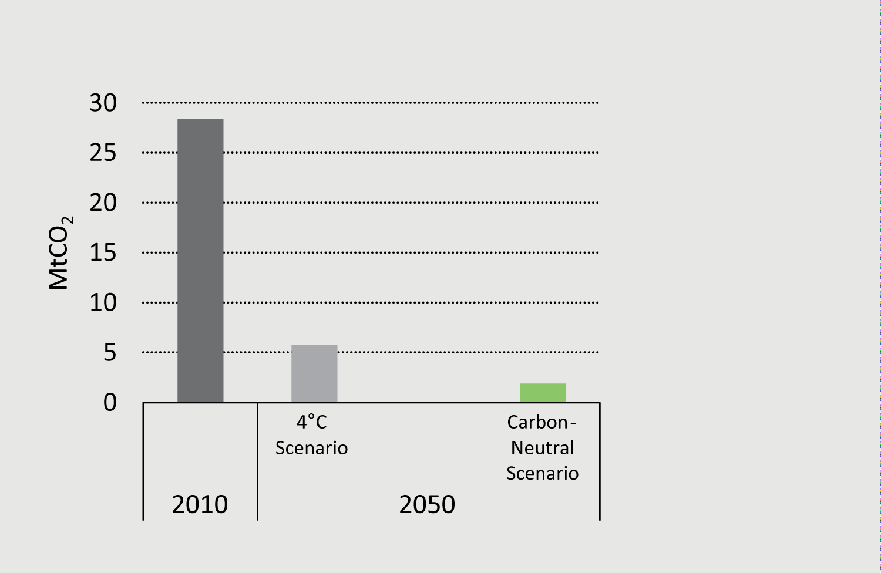
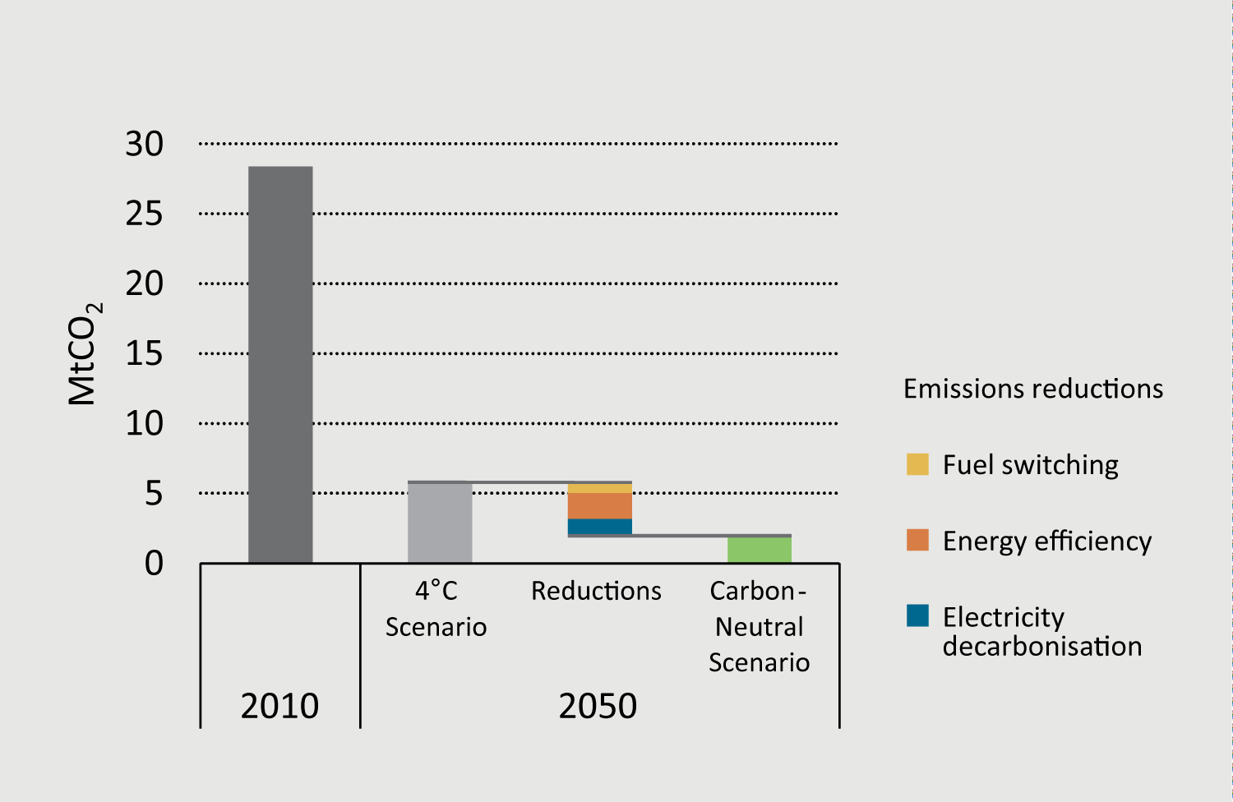
Nordic CO₂ emissions from residential buildings
75% of investments go to the building shell

Slide 20
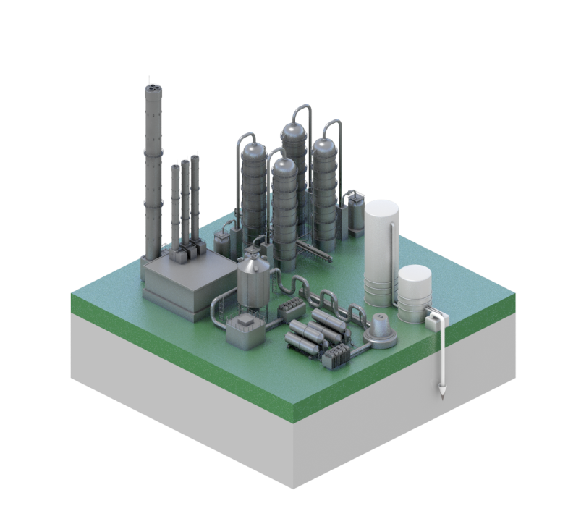
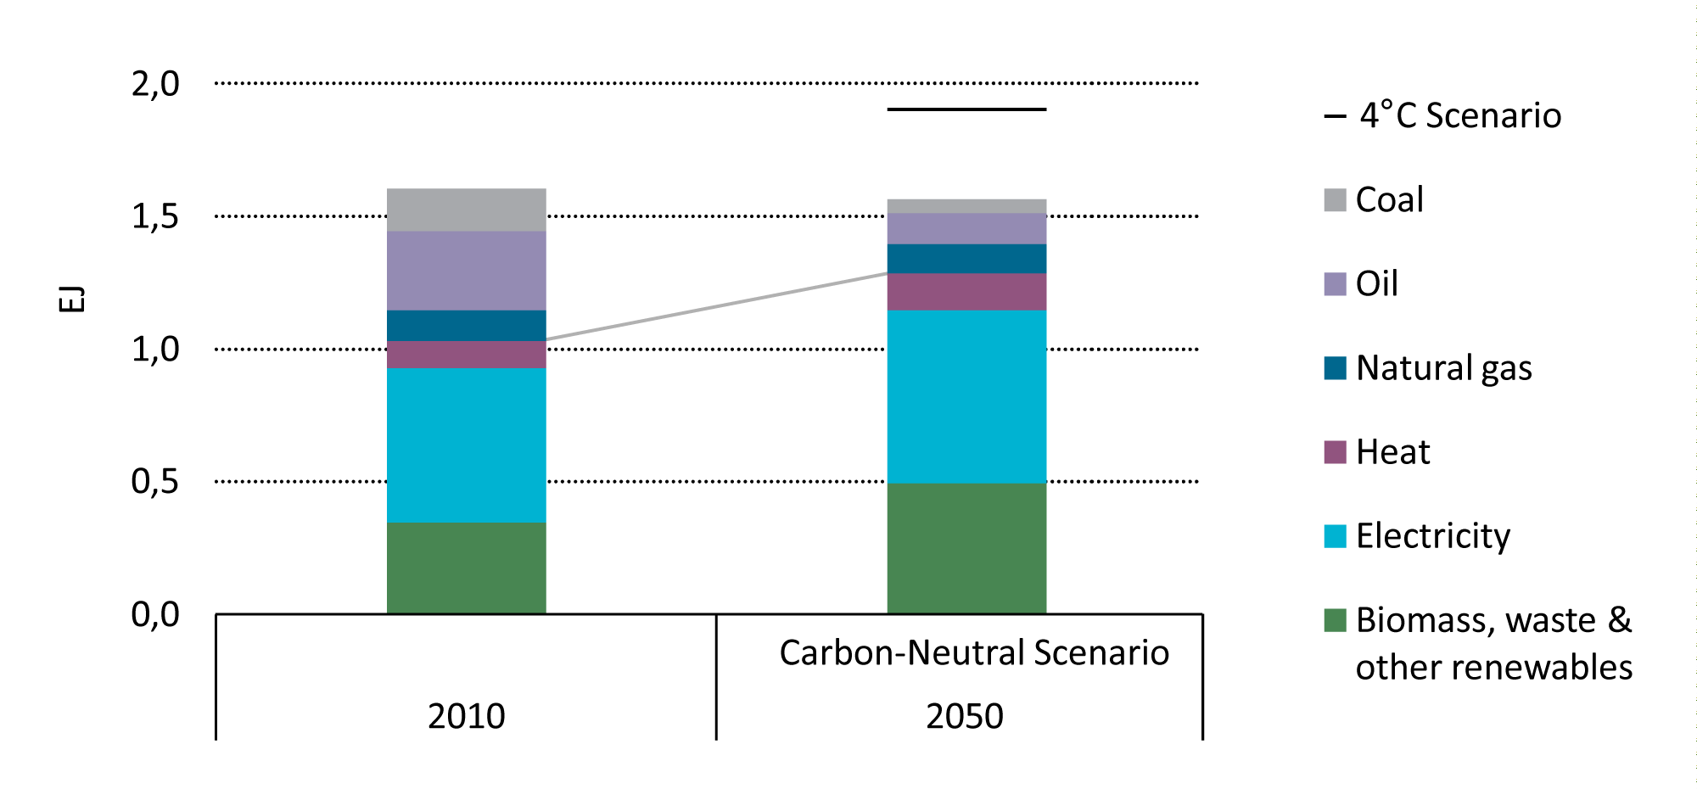
Final energy consumption in Nordic industry
Fossil fuel’s share of energy use drops from 40% to 20%, emissions drop by 70%

Slide 21
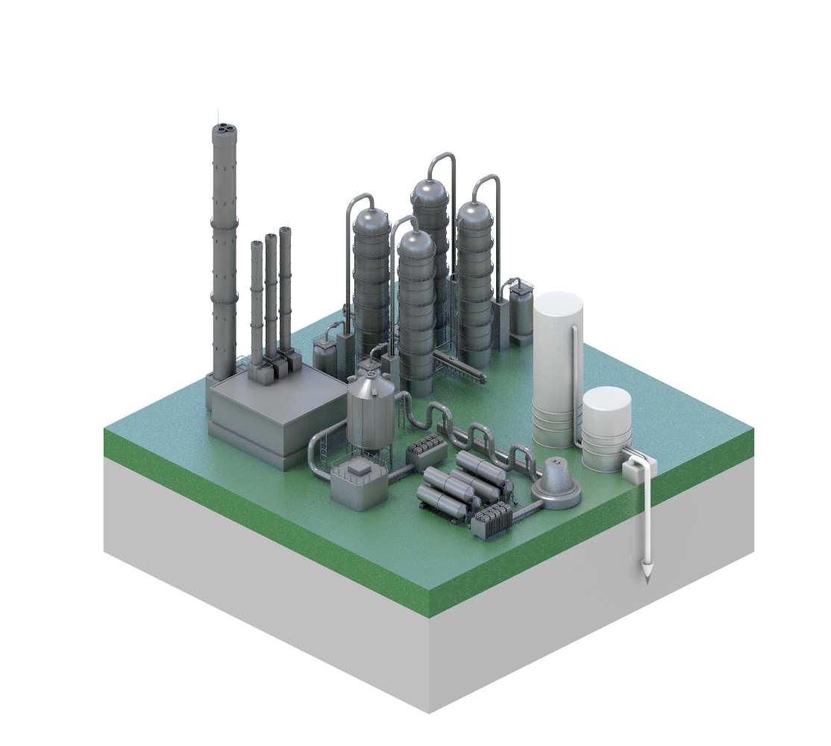
CCS utilisation in industry in 2050 in the Carbon-Neutral Scenario
50%
of cement plants
30%
of iron & steel,
chemical plants

Slide 22
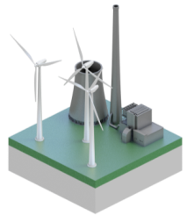
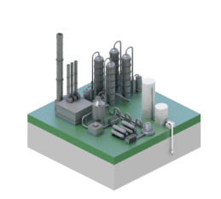
System integration important

Slide 23
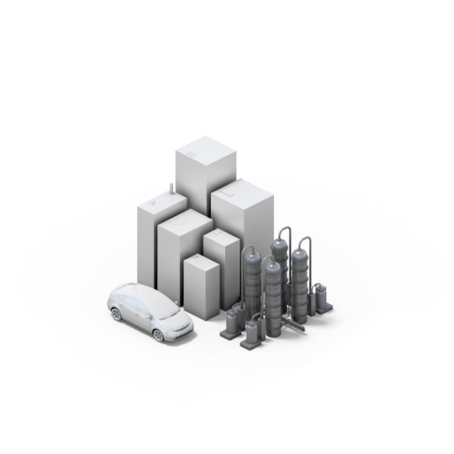
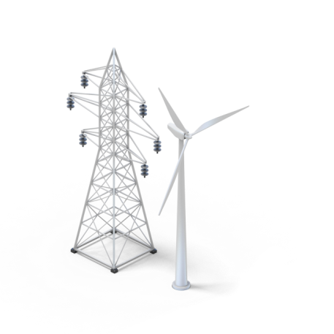
Key challenges
Energy
Efficiency
Biomass
Supply
CCS
Infrastructure

Slide 24
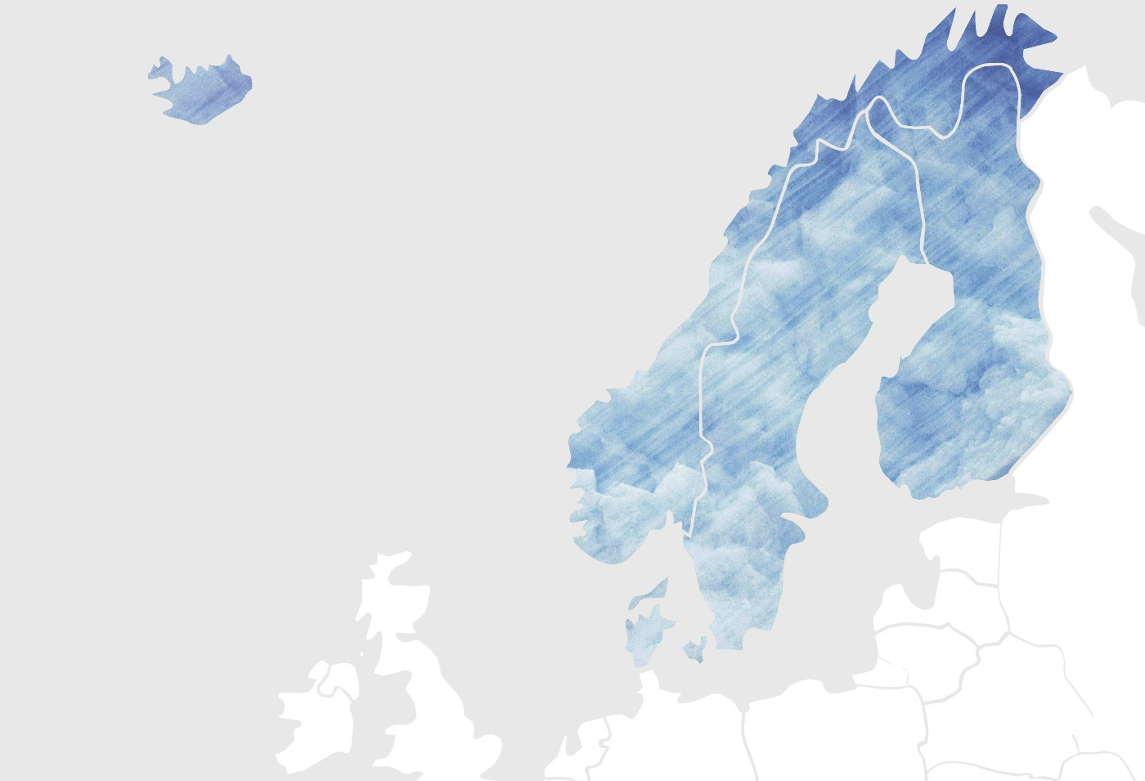
Nordic cooperation
a key factor
Cooperation potential evident in
infrastructure development, low-carbon RD&D and transport strategies

Slide 25
