Slide 1

Presentation of key results

Slide 2
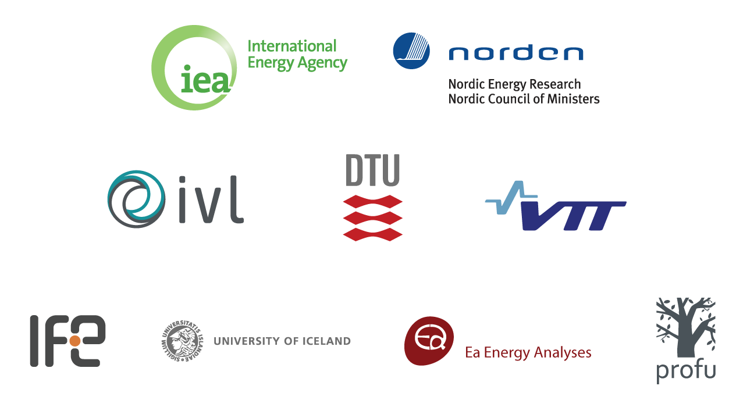
Notes:
The International Energy Agency (IEA)
IVL Swedish Environmental Research Institute (SE)
VTT Technical Research Centre of Finland (FI)
DTU Technical University of Denmark (DK)
IFE Institute for Energy Technology (NO)
University of Iceland (IS)
Ea Energy Analysis (DK)
Profu AB (SE)

Slide 3




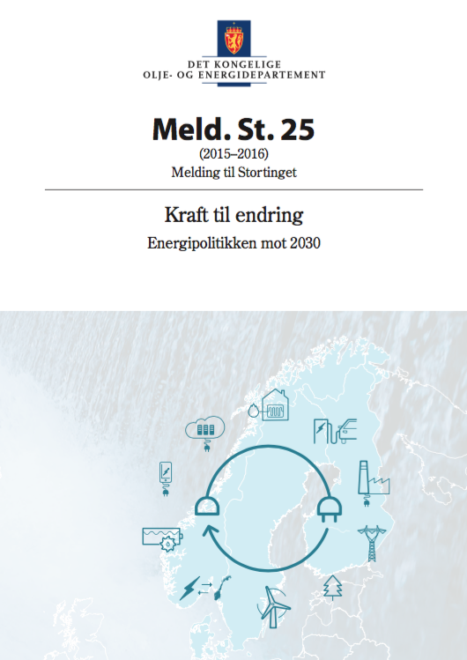
Bridging global and national analyses
Energikommissionen

Slide 4
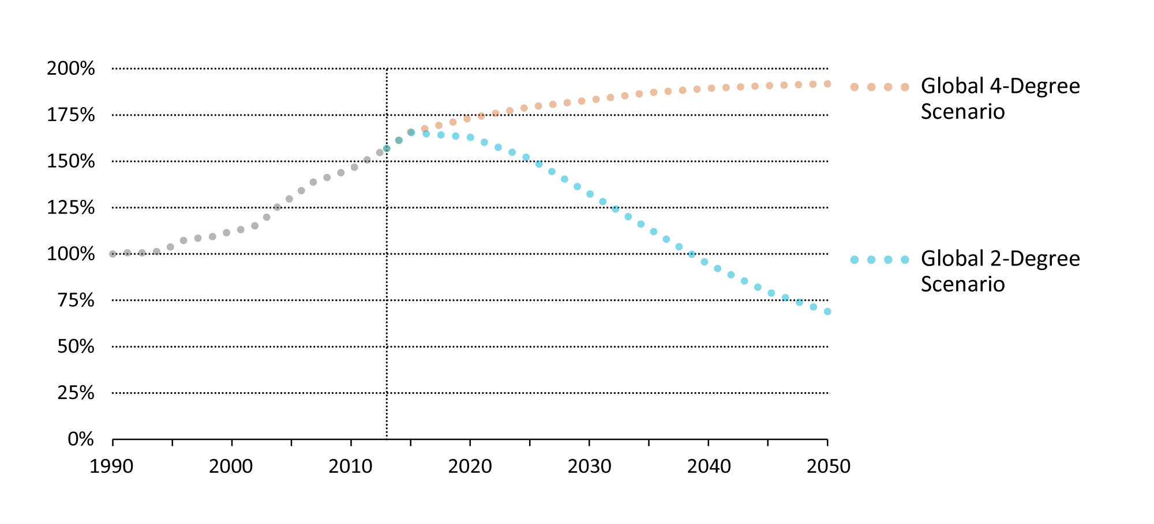
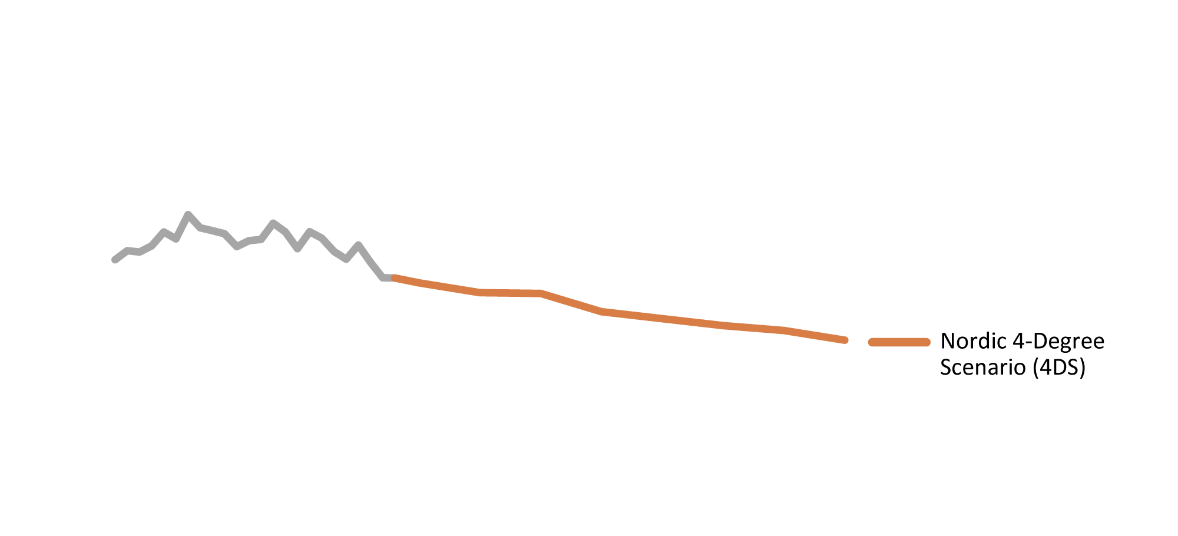
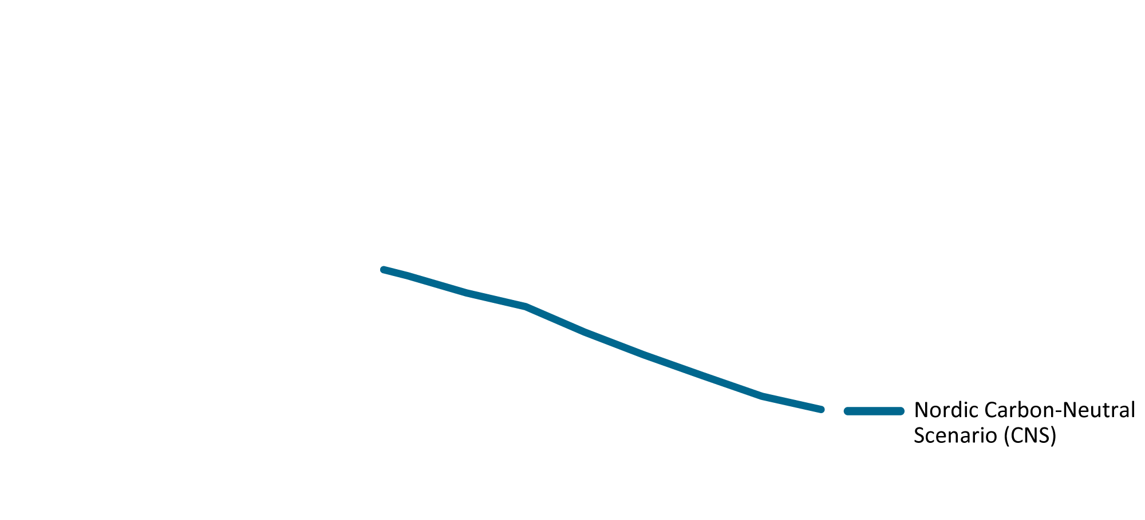
Global and Nordic scenarios in CO₂ emissions
In the Carbon-Neutral Scenario (CNS), Nordic CO₂ emissions drop by 85% in 2050 compared with 1990 levels
Notes:
The global 4°C Scenario represents a future in which strategic action limits global average temperature increase to 4°C.
The Nordic 4°C Scenario (4DS) is the Nordic contribution to the global 4°C Scenario and functions as the baseline scenario
for this study. The global 2°C Scenario reflects more aggressive approaches to limit the rise to 2°C. The Nordic Carbon-Neutral
Scenario (CNS) aims for even greater emissions reduction within the Nordic region (as the rest of the world pursues the global
2°C Scenario). Broadly in line with statements from Nordic governments, the CNS assumes a 15% share of emissions reduction
is achieved through offsets.

Slide 5


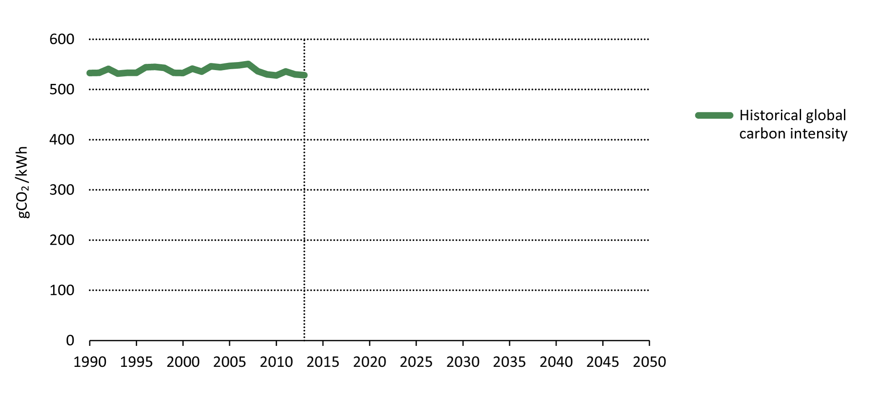
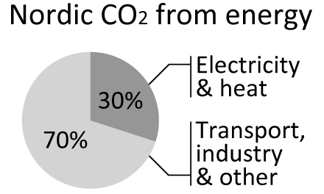
30 years ahead on electricity decarbonisation
Global carbon intensity of electricity (gCO₂/kWh)
Notes:
If we take a closer look at electricity only, the Nordic region is even further ahead.
The line shows the global carbon intensity of electricity, the amount of CO₂ emitted per kWh produced. According the IEA, if we are to meet the 2C target, the intensity will have to drop significantly by 2050.
The Nordic carbon intensity today is where the world needs to be in 30 years.
This is because of energy efficiency and renewables: First Hydropower from a century ago, then Nuclear three decades ago, and over the last two decades we’ve seen Bioenergy and Wind come in strong.
This is made possible be the Nordic electricity grid, which balances both long and short term variations in renewable energy production.
However, electricity and heat account for only a third of energy related CO₂. Unfortunately we don’t have such a lead on the rest of the world in transport and industry.

Slide 6
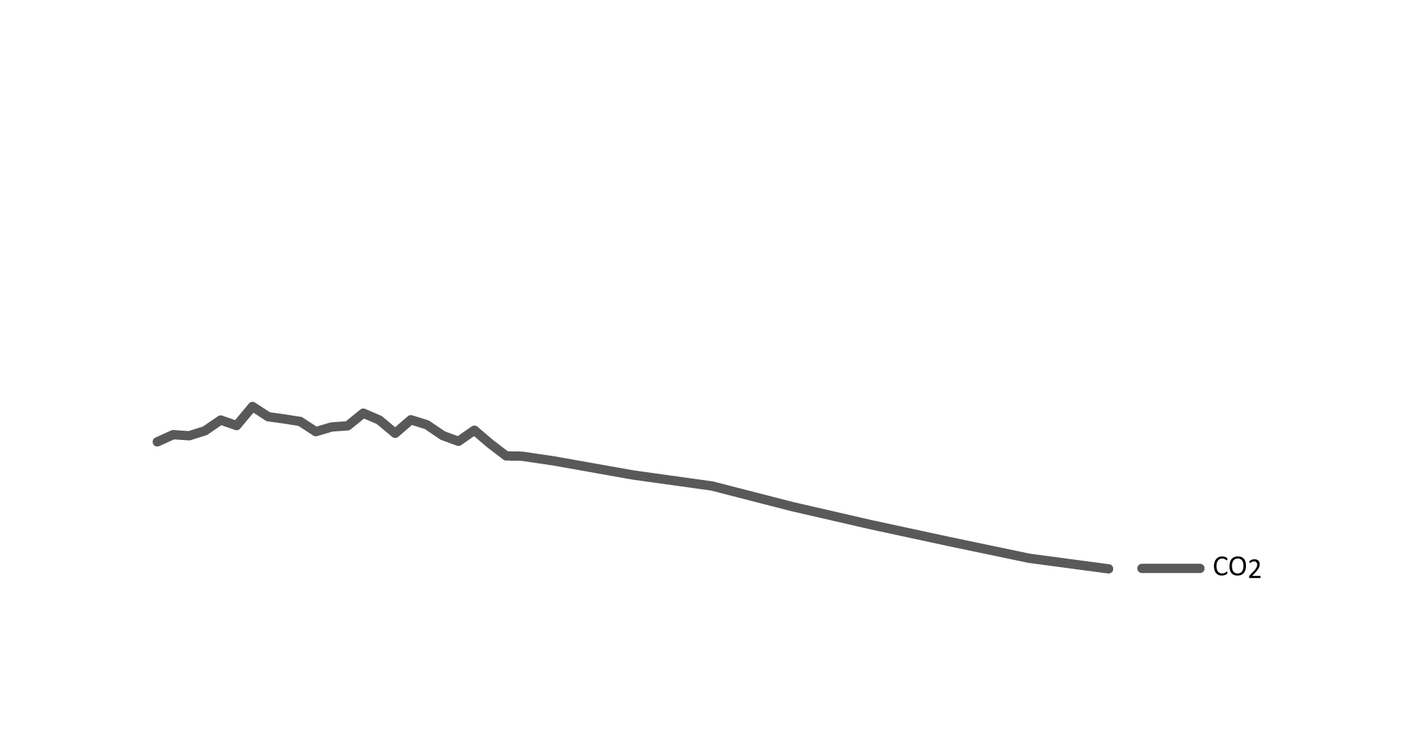
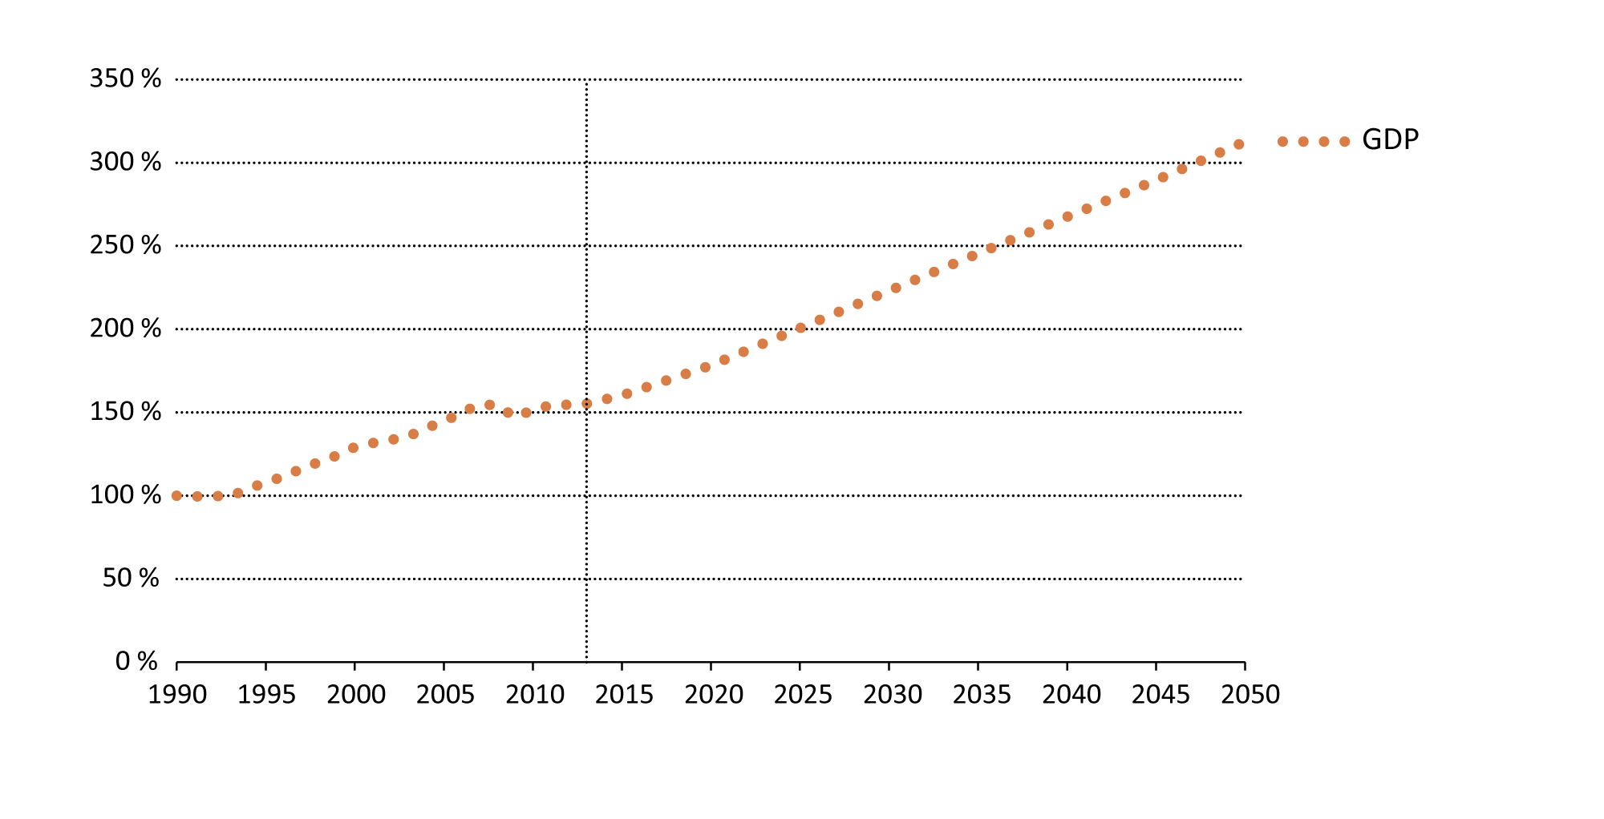
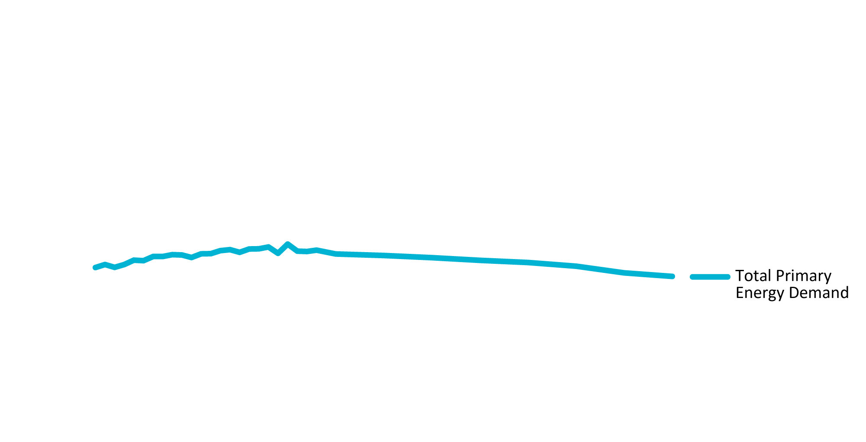
20 years ahead on decoupling
Nordic GDP, energy demand and CO₂ emissions (indexed)
Notes:
According to projections from national and international institutions (an external assumption to this analysis), Nordic GDP will rise towards 2050.
Nordic emissions have dropped due to energy efficiency and new renewables (bioenergy and wind)
This proves a long term decoupling for the world’s 12th largest economy,
Even after taking into account emissions in China from goods imported to the Nordic region, the decoupling is evident (see special box in report).

Slide 7
Three strategic actions
Incentivise and plan for a more distributed, interconnected and flexible energy system
Tap into the positive momentum of cities in transport and buildings
Ramp up decarbonisation of long-distance transport and the industrial sector

Slide 8
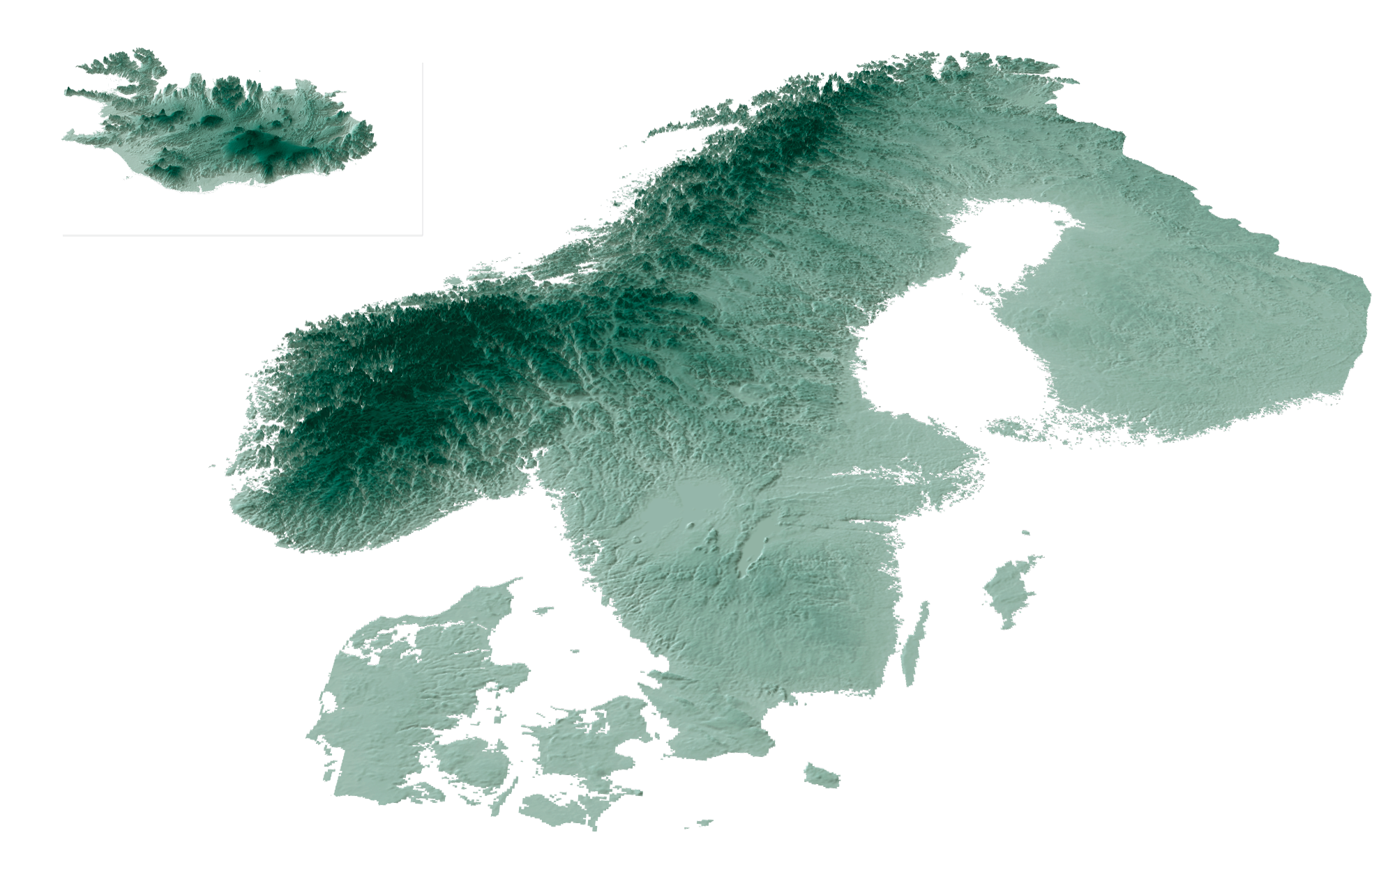

Slide 9
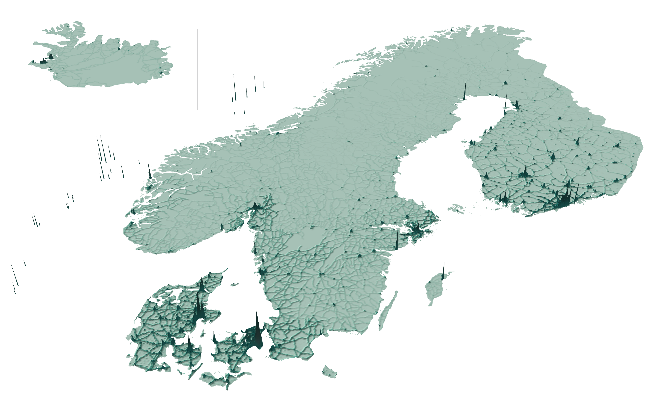

Visualisation of Nordic CO₂ emissions, 2013

Slide 11
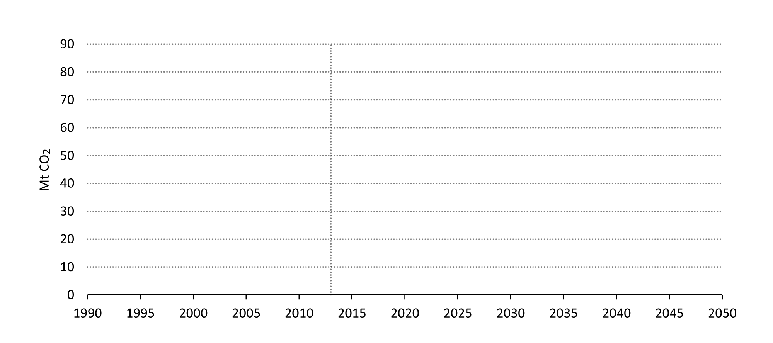
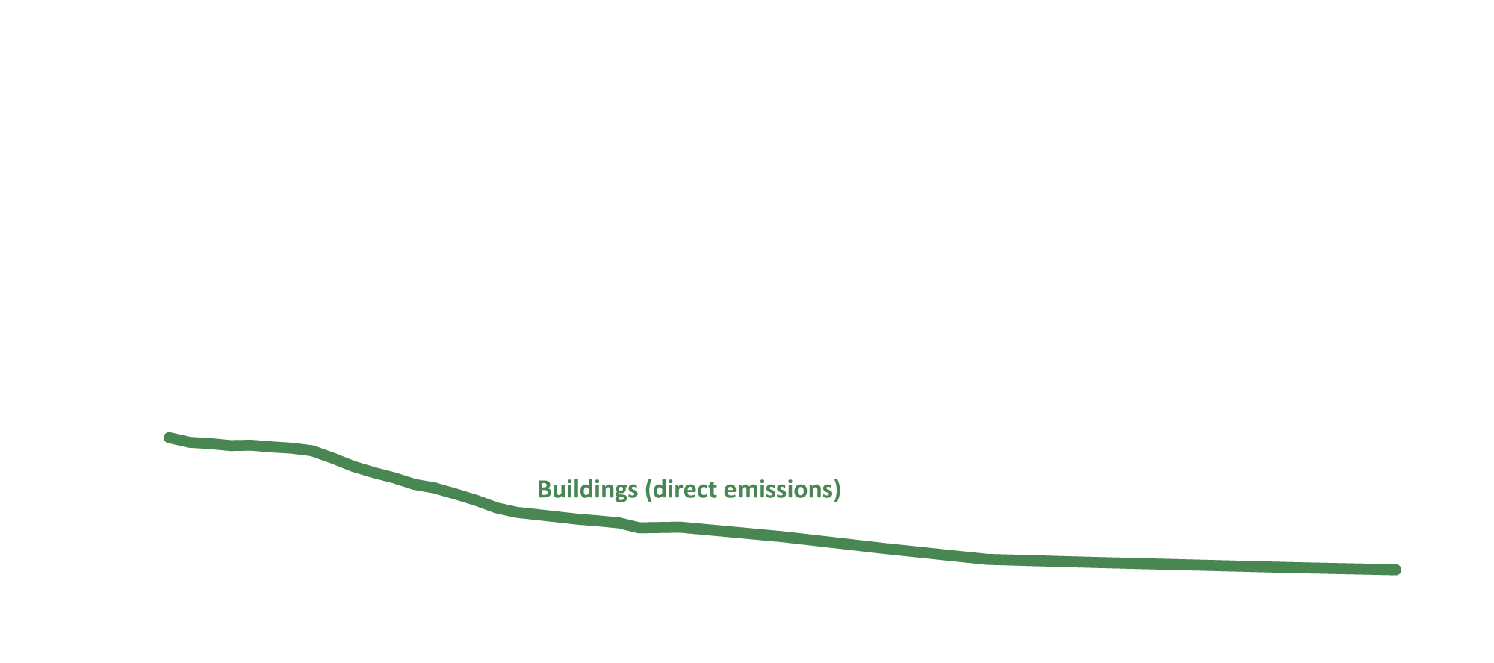
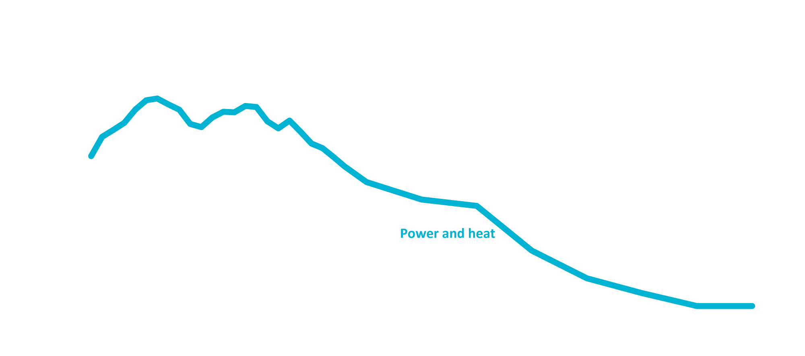


Demand sectors most challenging
Nordic CO₂ emissions in the CNS

Slide 12
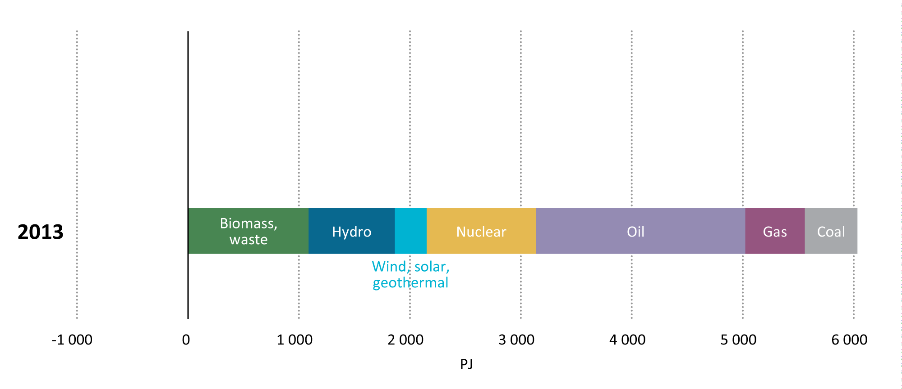

Transforming the energy system
Nordic Total Primary Energy Supply in the CNS

Slide 13
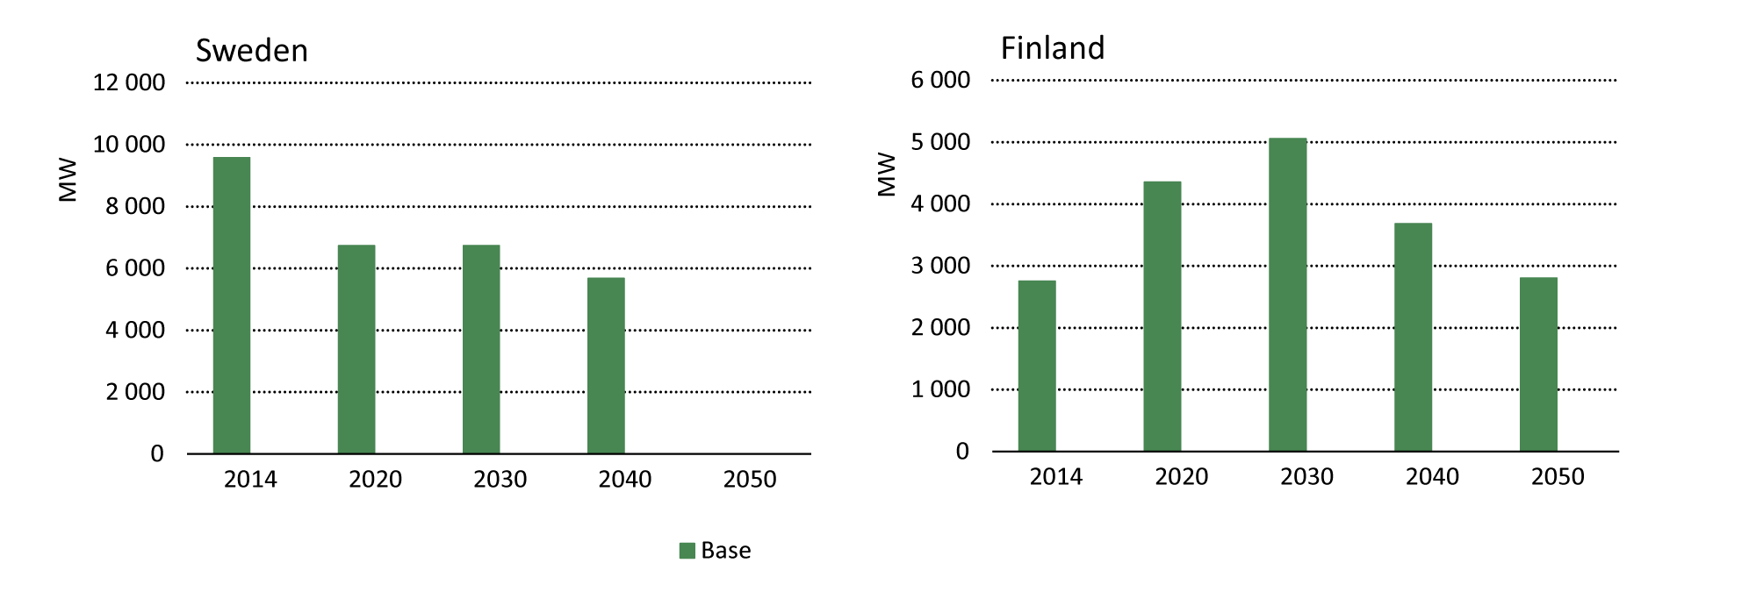

Early nuclear phase-out increases emissions
Nordic nuclear capacity in the CNS and a fast phase-out sensitivity analysis

Slide 14
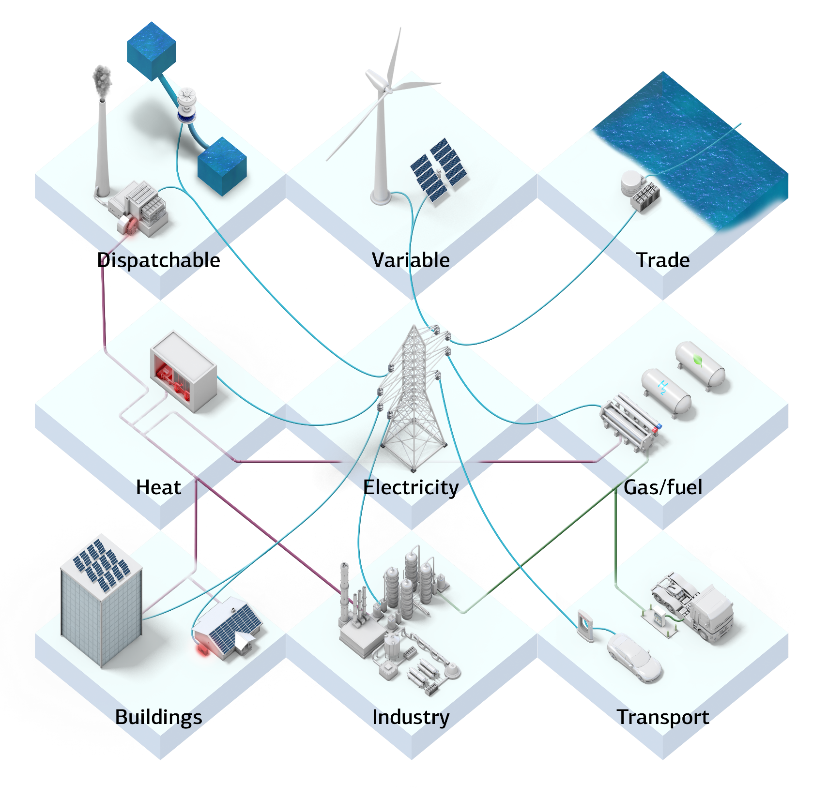

Slide 15
Three strategic actions
Incentivise and plan for a more distributed, interconnected and flexible energy system
Tap into the positive momentum of cities in transport and buildings
Ramp up decarbonisation of long-distance transport and the industrial sector

Slide 19
3-4 GW
of utility-scale
heat pumps in 2050

Slide 21

5-6 GW
in 2050
5-6 GW
in 2050
1-2 GW
in 2050

Slide 26
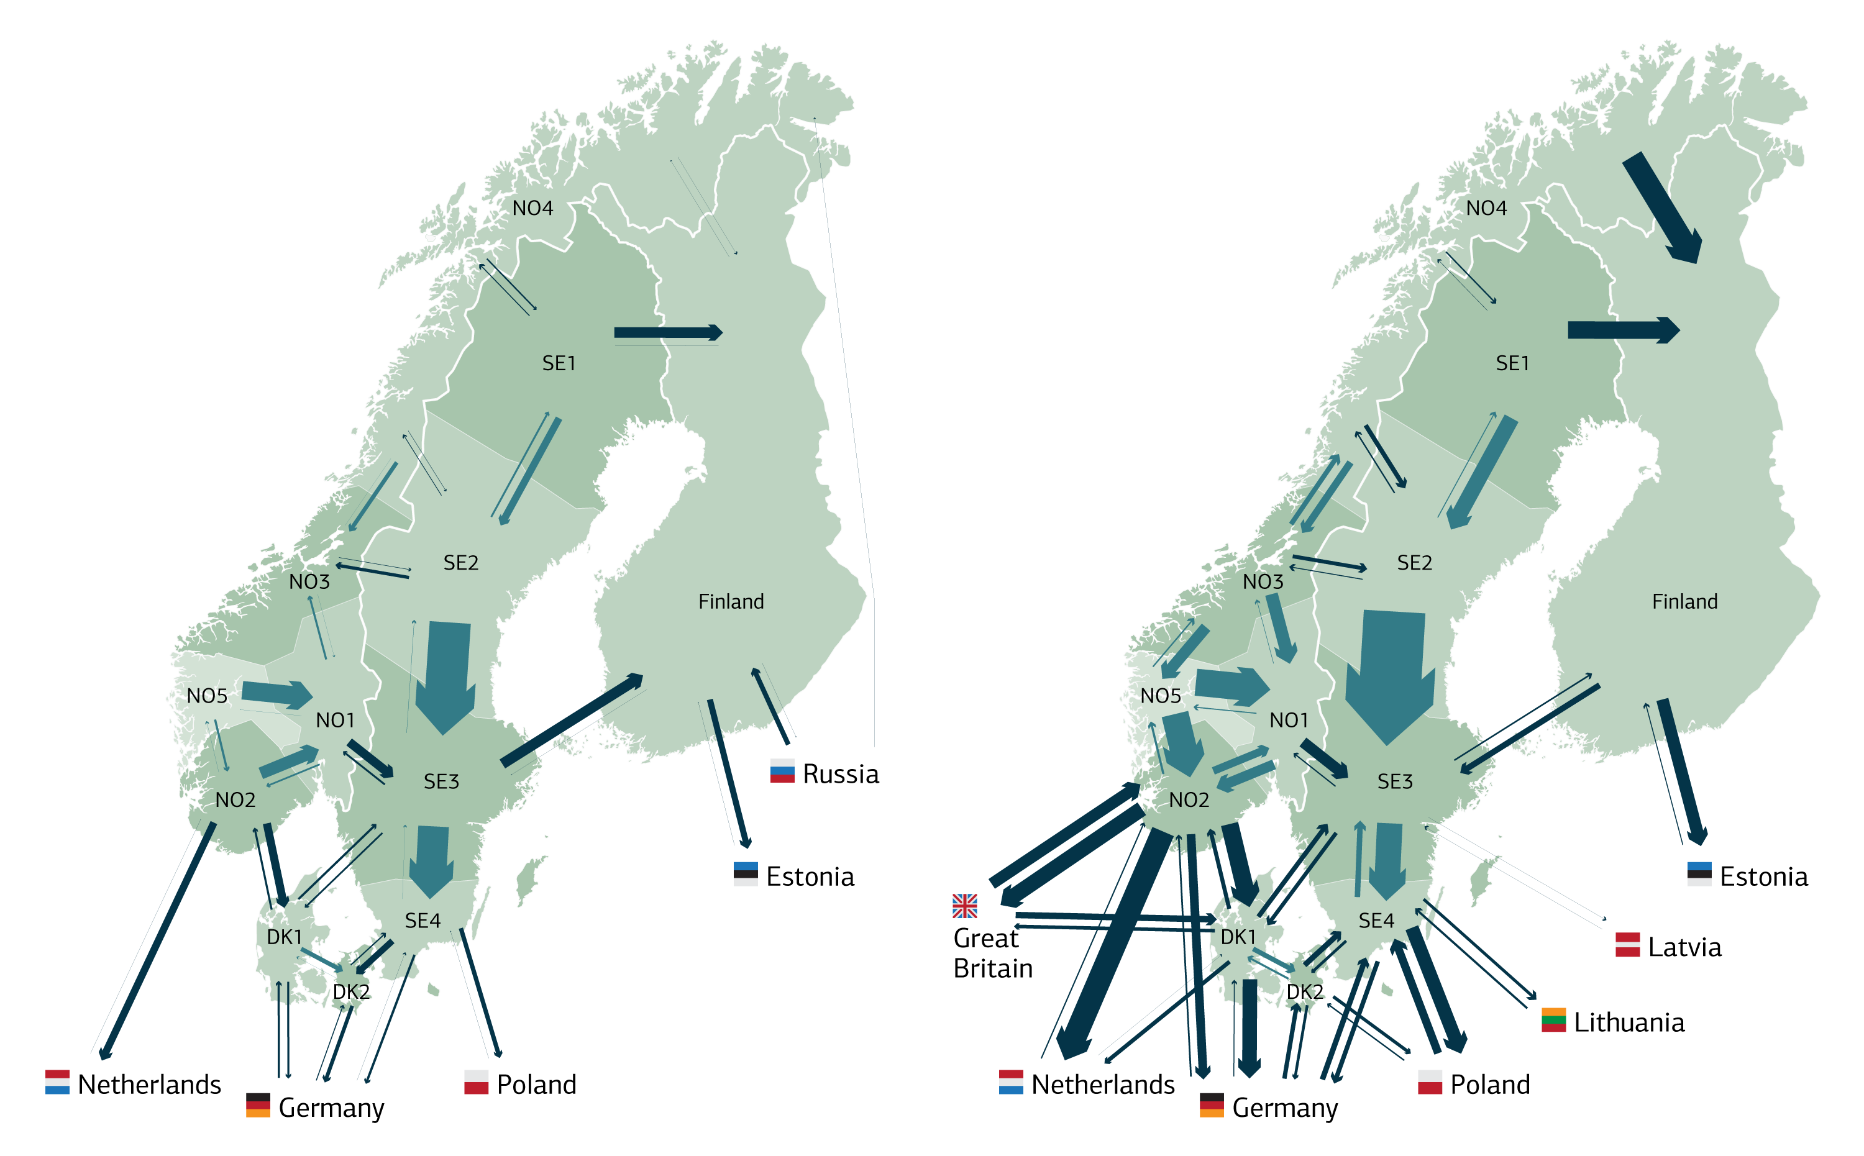
Electricity trade
2015
2050
5 GW capacity to Europe
23 GW capacity to Europe
28 TWh trade activity with Europe
125 TWh trade activity with Europe
14 TWh net export to Europe
53 TWh net export to Europe
Electricity trade

Slide 28
Three strategic actions
Incentivise and plan for a more distributed, interconnected and flexible energy system
Tap into the positive momentum of cities in transport and buildings
Ramp up decarbonisation of long-distance transport and the industrial sector

Slide 29


Slide 30
Space heating energy intensity in Nordic buildings
126
0.8%
kWh/m² in 2013
annual improvement,
1990-2013
60
2.2%
kWh/m² in 2015
annual improvement,
2013-2050

Slide 31


Slide 32
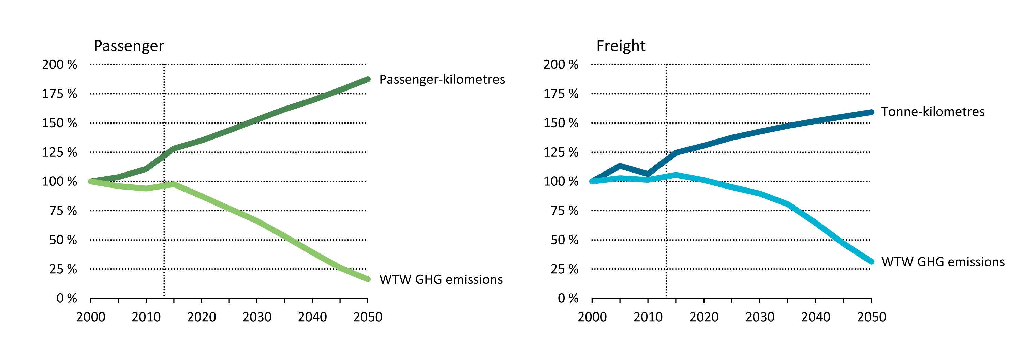
Decoupling transport activity from emissions

Slide 33

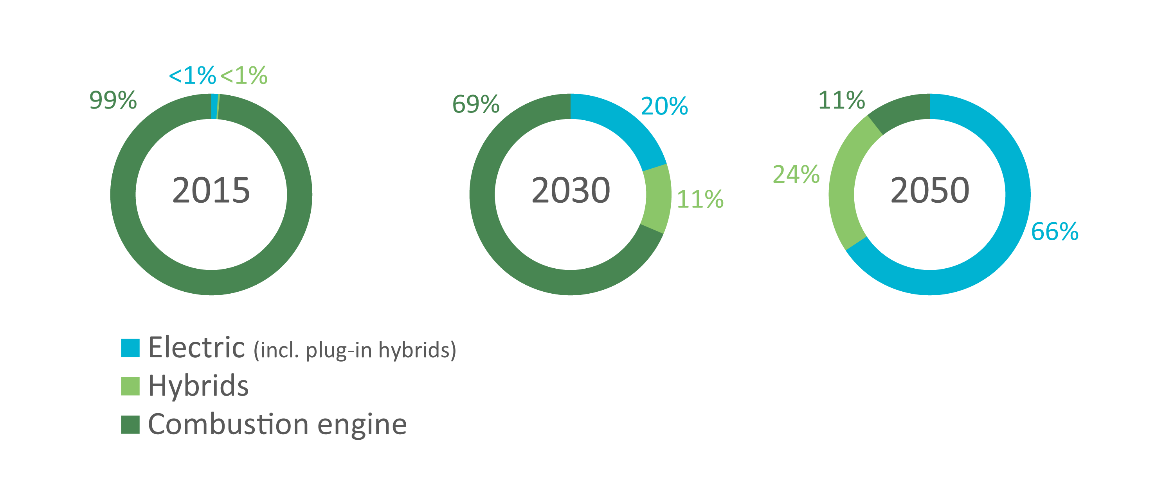
Rapid electrification of transport
Nordic stock of cars and light commercial vehicles in the CNS

Slide 34
Three strategic actions
Incentivise and plan for a more distributed, interconnected and flexible energy system
Tap into the positive momentum of cities in transport and buildings
Ramp up decarbonisation of long-distance transport and the industrial sector

Slide 35

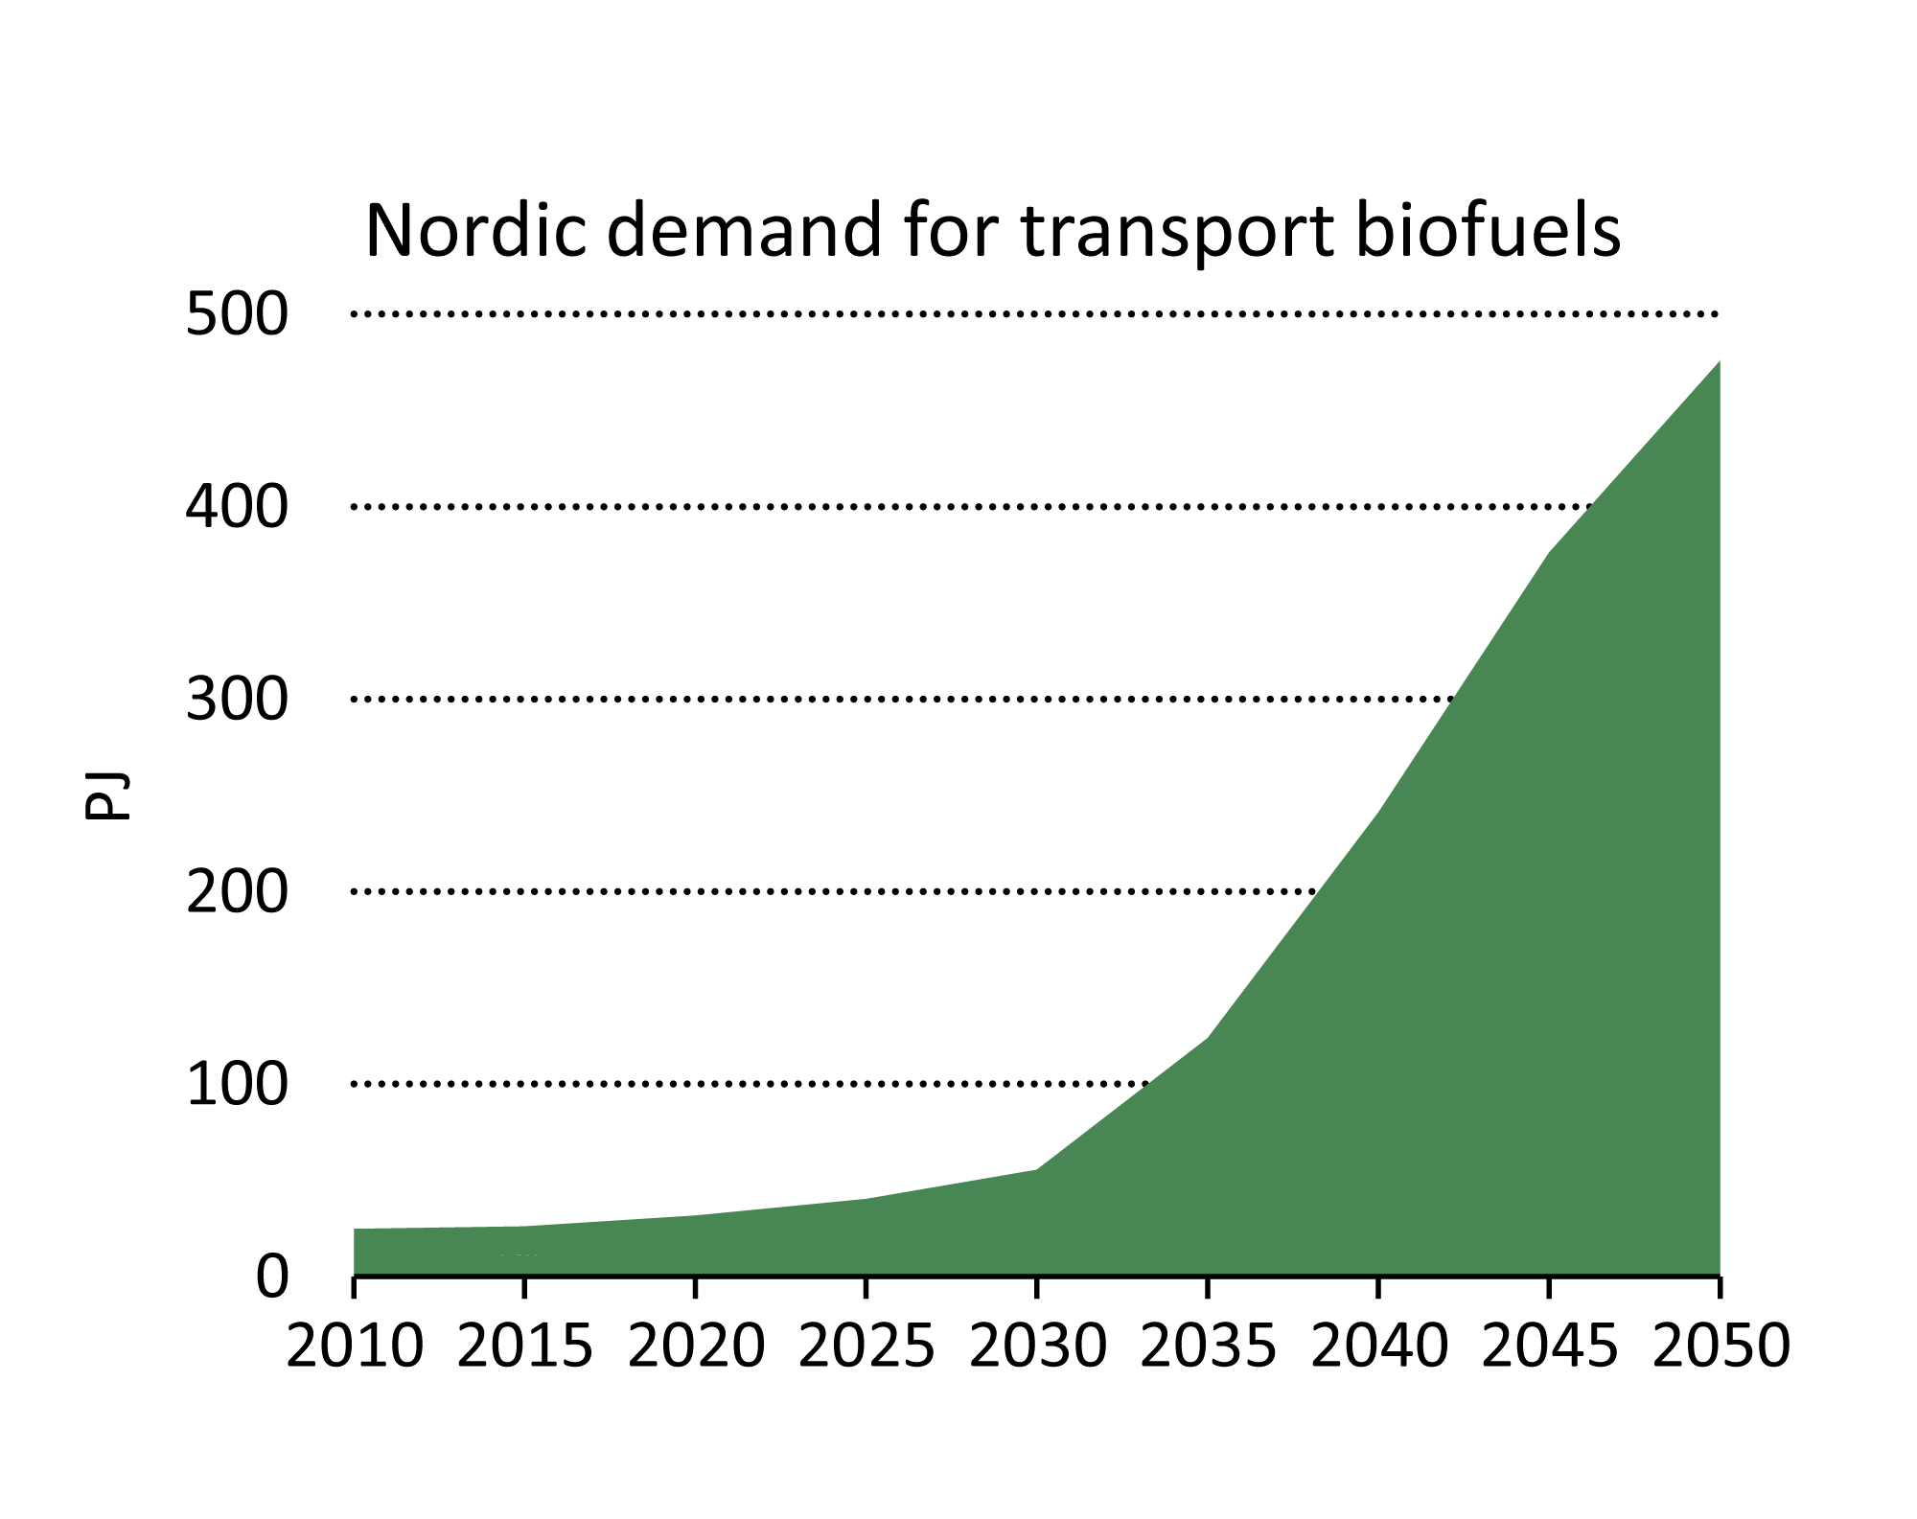
Long-distance transport

Slide 36

15%
import dependency
for biomass in 2050,
up from 8% in 2013

Slide 37






Visualisation of Nordic CO₂ emissions, 2013

Slide 38
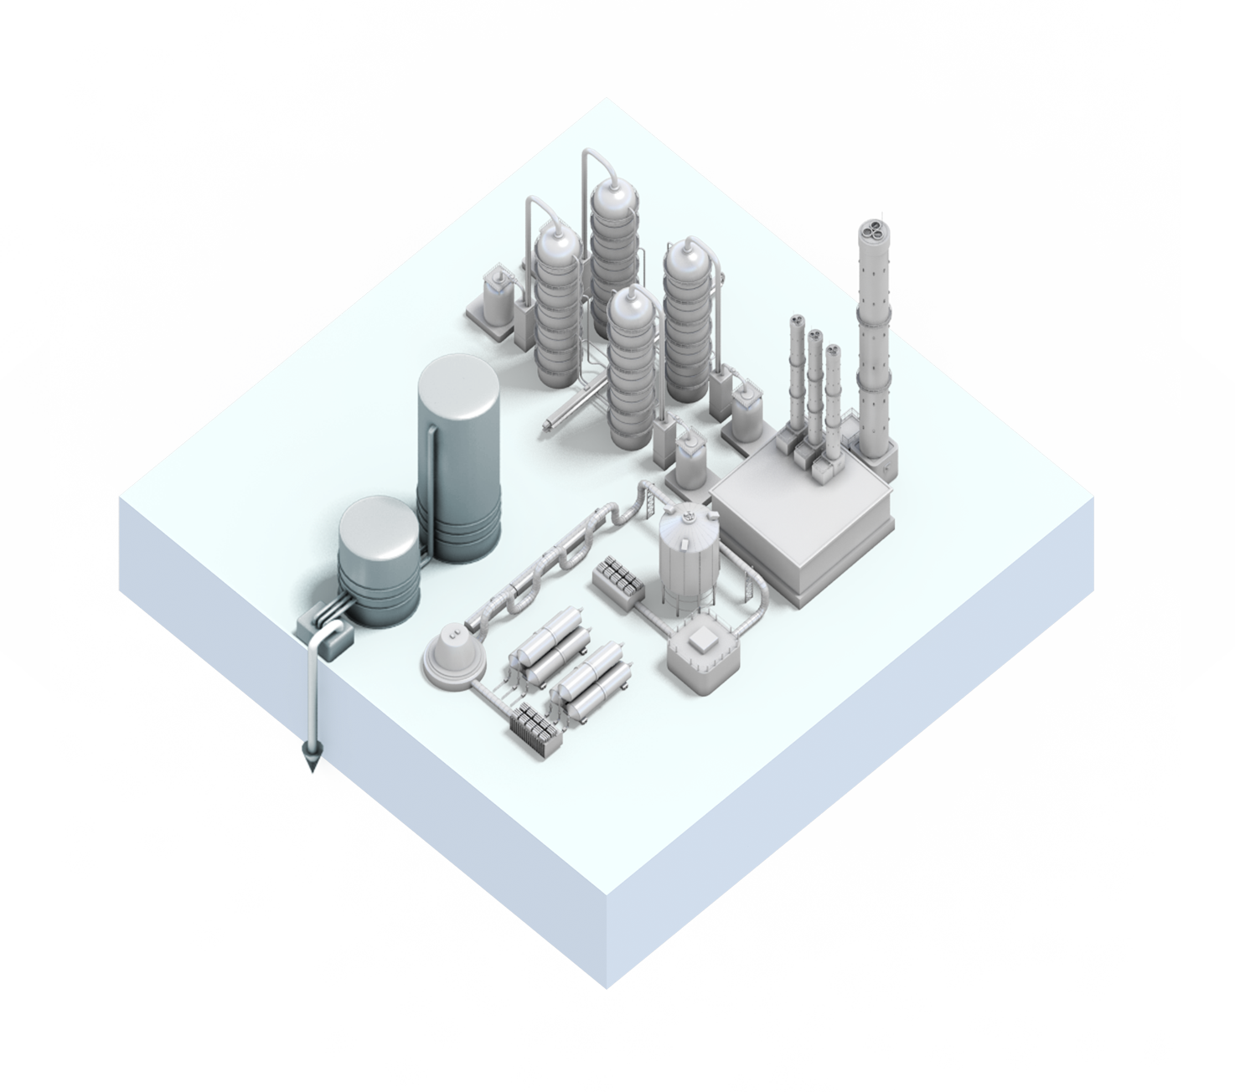

CCS critical in industry
Nordic industrial emissions in 2050
Total
Captured
20 Mt CO₂
7 Mt CO₂

Slide 39
Three strategic actions
Incentivise and plan for a more distributed, interconnected and flexible energy system
Tap into the positive momentum of cities in transport and buildings
Ramp up decarbonisation of long-distance transport and the industrial sector

Slide 40
Thank you
www.NordicETP.org
Download figures, data and slides
Order a free hard copy

